Slide 1
Week 2 – Generative Modeling I
Mastering Diffusion
Introduction to Generative Modeling
Jihwan Hong
AIDAS Lab
Seoul National University
csjihwanh@gmail.com

Slide 2
Generative Modeling

Slide 3
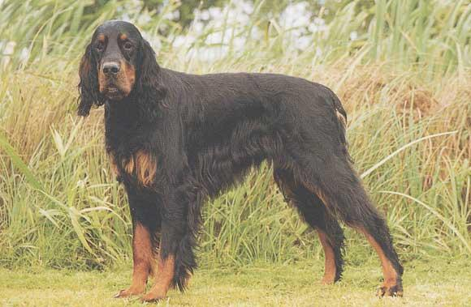
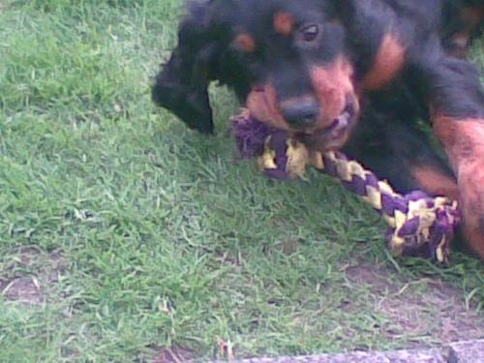
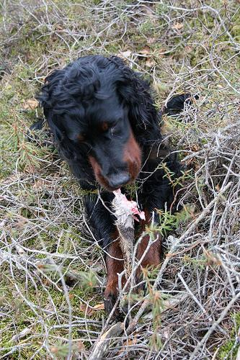
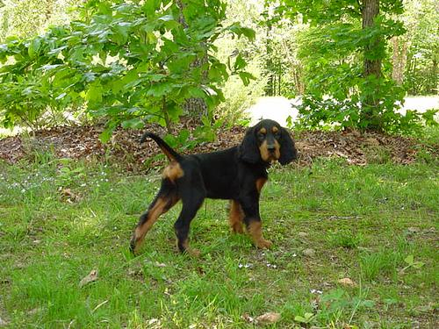

Generative Models
Generative Modeling
Generative model is a model that can generate new data instances
Data $X$
Images from ILSVRC 2012 (Russakovsky et al., IJCV 2015)

Slide 4
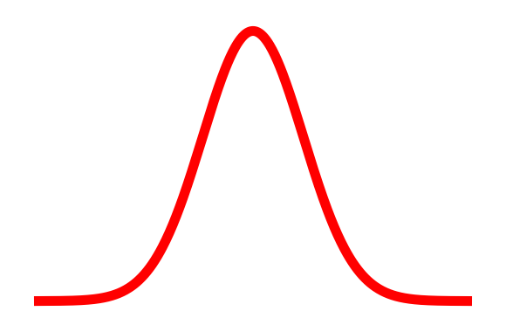

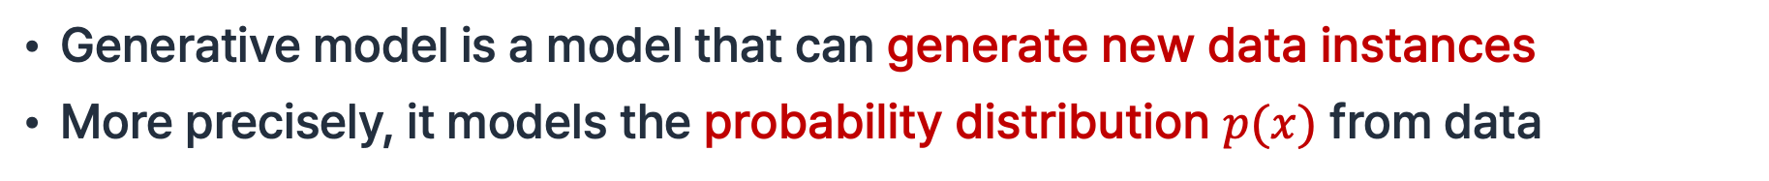
Generative Models
Generative Modeling
Generative model is a model that can generate new data instances
More precisely, it models the probability distribution $p(x)$ from data
Learn
Data $X$
Probability Distribution $p(x)$
Images from ILSVRC 2012 (Russakovsky et al., IJCV 2015)

Slide 5
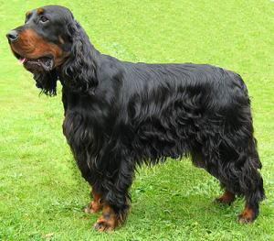

Generative Models
Generative Modeling
Generative model is a model that can generate new data instances
More precisely, it models the probability distribution $p(x)$ from data
Learn
Sample
Data $X$
Probability Distribution $p(x)$
Generated data $\hat{x}$
Images from ILSVRC 2012 (Russakovsky et al., IJCV 2015)

Slide 6
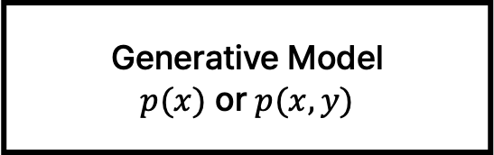
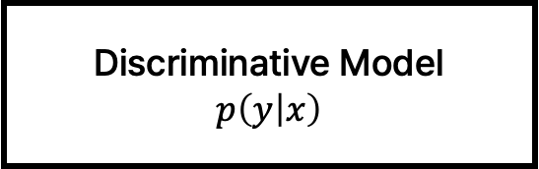
Discriminative vs. Generative
Generative Modeling
Discriminative Model
$$p\left(y | x\right)$$
Generative Model
$$p(x) \text{or} p(x,y)$$

Slide 7

Discriminative vs. Generative
Generative Modeling
Discriminative Model
$$p\left(y | x\right)$$
Generative Model
$$p(x) \text{or} p(x,y)$$
Discriminative models estimate p(y|x) for predefined labels

Slide 8
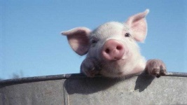


Discriminative vs. Generative
Generative Modeling
Discriminative Model
$$p\left(y | x\right)$$
Generative Model
$$p(x) \text{or} p(x,y)$$
Discriminative models estimate p(y|x) for predefined labels
$x$: image
$y$: pig

Slide 9
Discriminative vs. Generative
Generative Modeling
Discriminative Model
$$p\left(y | x\right)$$
Generative Model
$$p(x) \text{or} p(x,y)$$
Discriminative models estimate p(y|x) for predefined labels
Label: pig

Slide 10


Discriminative vs. Generative
Generative Modeling
Discriminative Model
$$p\left(y | x\right)$$
Generative Model
$$p(x) \text{or} p(x,y)$$
Classify
$$p(pig|x)$$
$$p(duck|x)$$
Label: pig
Prediction: pig

Slide 11
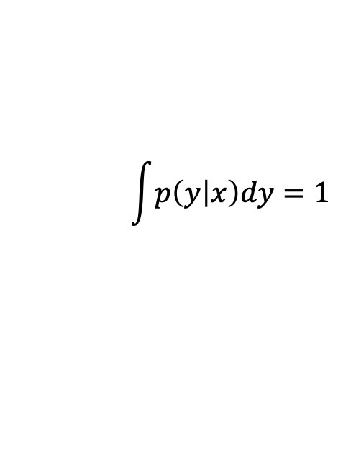
Discriminative vs. Generative
Generative Modeling
Discriminative Model
$$p\left(y | x\right)$$
Generative Model
$$p(x) \text{or} p(x,y)$$
$$\int{p\left(y | x\right)dy=1}$$
Classify
$$p(pig|x)$$
$$p(duck|x)$$
Label: pig
Prediction: pig

Slide 12
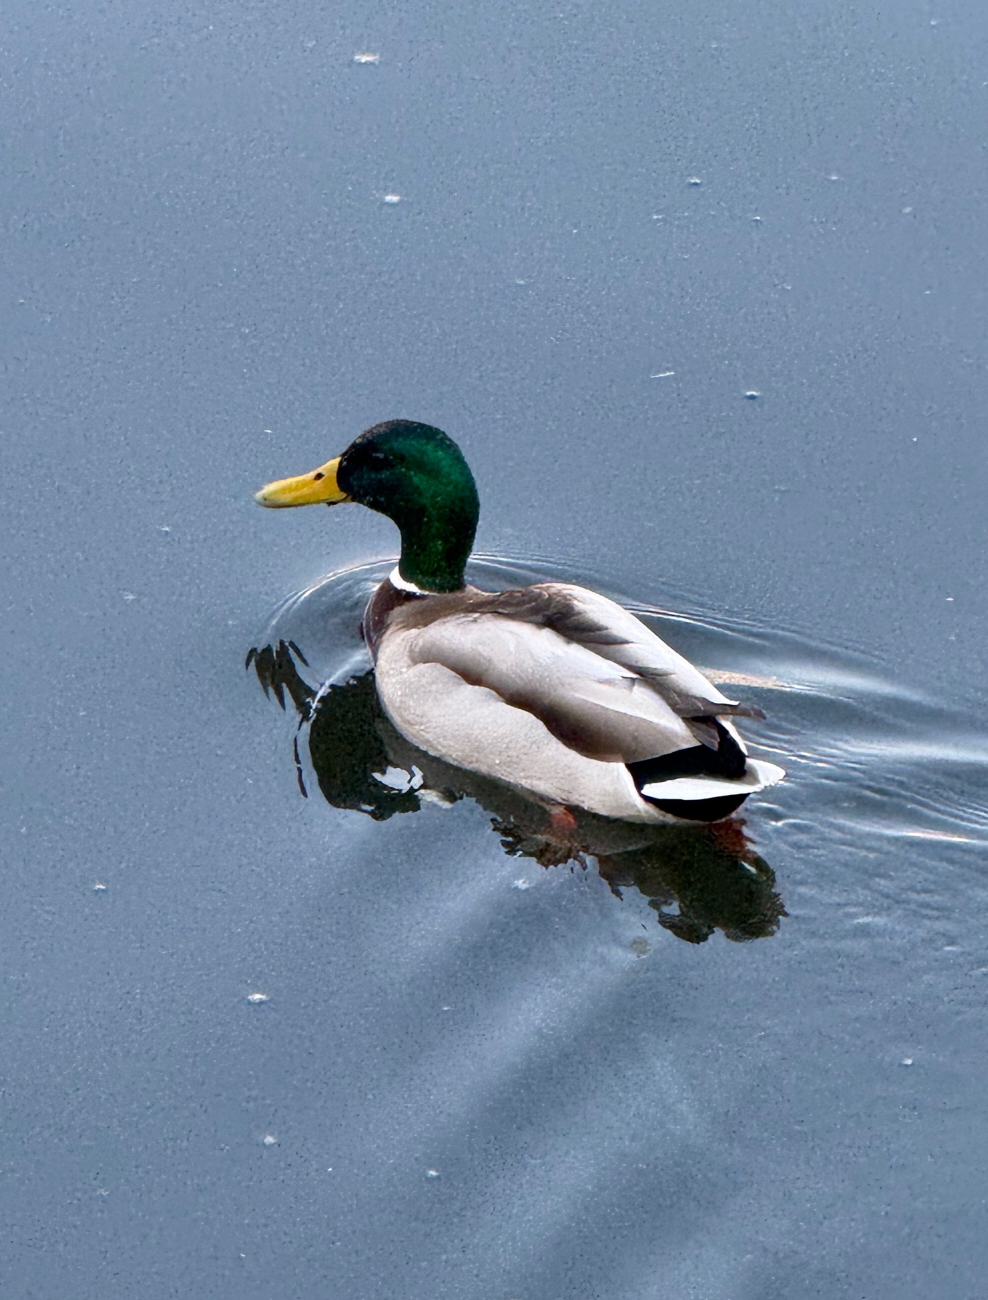
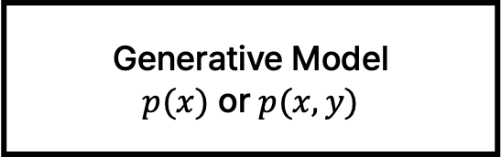
Discriminative vs. Generative
Generative Modeling
Discriminative Model
$$p\left(y | x\right)$$
Generative Model
$p(x)$ or $p(x,y)$
Classify
$$p(pig|x)$$
$$p(duck|x)$$
Label: duck
Prediction: duck

Slide 13
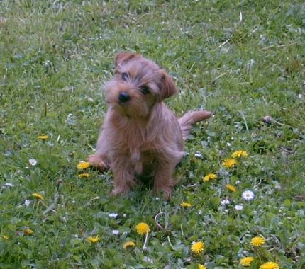
Discriminative vs. Generative
Generative Modeling
Discriminative Model
$$p\left(y | x\right)$$
Generative Model
$p(x)$ or $p(x,y)$
Classify
$$p(pig|x)$$
$$p(duck|x)$$
Label: dog
Prediction: pig
Images from ILSVRC 2012 (Russakovsky et al., IJCV 2015)

Slide 14
Discriminative vs. Generative
Generative Modeling
Discriminative Model
$$p\left(y | x\right)$$
Generative Model
$p(x)$ or $p(x,y)$
No way to compute p(y|x) for undefined labels
Classify
$$p(pig|x)$$
$$p(duck|x)$$
Label: dog
Prediction: pig
Images from ILSVRC 2012 (Russakovsky et al., IJCV 2015)

Slide 15
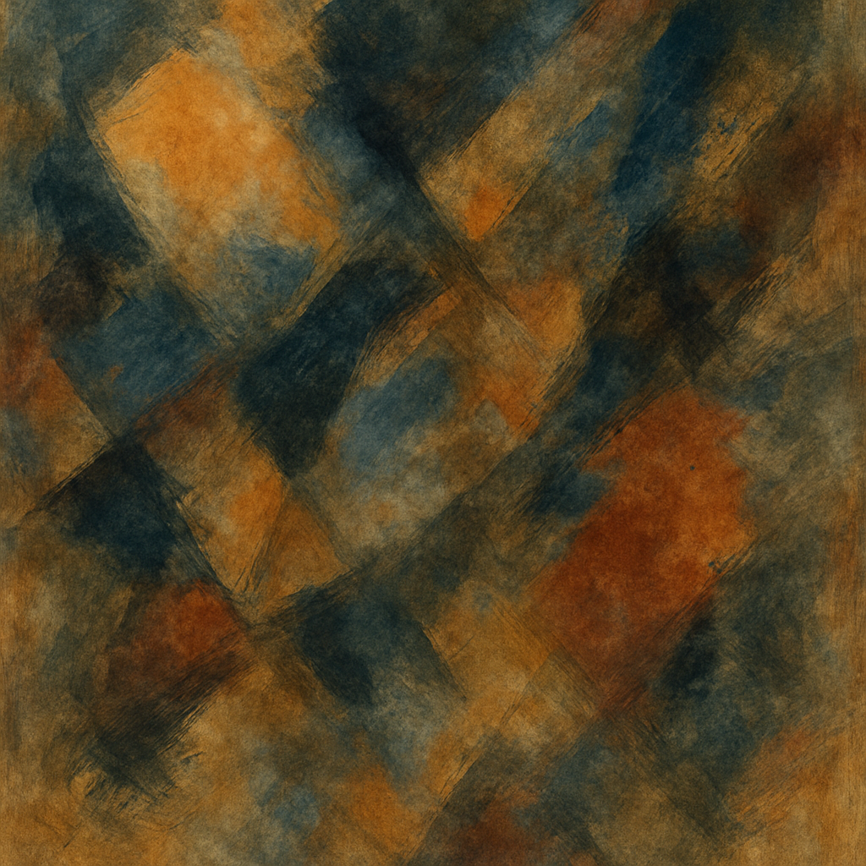
Discriminative vs. Generative
Generative Modeling
Discriminative Model
$$p\left(y | x\right)$$
Generative Model
$p(x)$ or $p(x,y)$
No way to compute p(y|x) for undefined labels
Classify
$$p(pig|x)$$
$$p(duck|x)$$
Label: ??
Prediction: duck

Slide 16
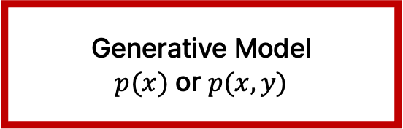
Discriminative vs. Generative
Generative Modeling
Discriminative Model
$$p\left(y | x\right)$$
Generative Model
$$p(x) \text{or} p(x,y)$$
Generative models estimate how likely an image is

Slide 17

Discriminative vs. Generative
Generative Modeling
Discriminative Model
$$p\left(y | x\right)$$
Generative Model
$$p(x) \text{or} p(x,y)$$
Generative models estimate how likely an image is
…
$$p( )$$

Slide 18



Discriminative vs. Generative
Generative Modeling
Discriminative Model
$$p\left(y | x\right)$$
Generative Model
$$p(x) \text{or} p(x,y)$$
Generative models estimate how likely an image is
…
$$p( )$$
$$p( )$$
$$p( )$$
$$p( )$$
Images from ILSVRC 2012 (Russakovsky et al., IJCV 2015)

Slide 19
Discriminative vs. Generative
Generative Modeling
Discriminative Model
$$p\left(y | x\right)$$
Generative Model
$$p(x) \text{or} p(x,y)$$
Or, generative models estimate how likely x and y occur together

Slide 20




Discriminative vs. Generative
Generative Modeling
Discriminative Model
$$p\left(y | x\right)$$
Generative Model
$$p(x) \text{or} p(x,y)$$
Or, generative models estimate how likely x and y occur together
…
$$p(x,pig)$$
$$p(x,duck)$$
$$p(x,dog)$$
$$p(x,monkey)$$
Label: pig

Slide 21




Discriminative vs. Generative
Generative Modeling
Discriminative Model
$$p\left(y | x\right)$$
Generative Model
$$p(x) \text{or} p(x,y)$$
Or, generative models estimate how likely x and y occur together
We can build a discriminative model from this
…
$$p(x,pig)$$
$$p(x,duck)$$
$$p(x,dog)$$
$$p(x,monkey)$$
Label: pig

Slide 22
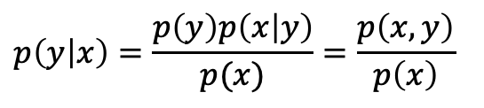
Discriminative vs. Generative
Generative Modeling
Discriminative Model
$$p\left(y | x\right)$$
Generative Model
$$p(x) \text{or} p(x,y)$$
Or, generative models estimate how likely x and y occur together
We can build a discriminative model from this
Recap: Bayes’ Rule
$$p\left(y | x\right)=\frac{p\left(y\right)p\left(x | y\right)}{p(x)}=\frac{p\left(x,y\right)}{p\left(x\right)}$$
…
$$p(x,pig)$$
$$p(x,duck)$$
$$p(x,dog)$$
$$p(x,monkey)$$
Label: pig

Slide 23
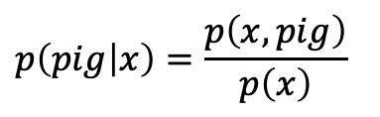
Discriminative vs. Generative
Generative Modeling
Discriminative Model
$$p\left(y | x\right)$$
Generative Model
$$p(x) \text{or} p(x,y)$$
Or, generative models estimate how likely x and y occur together
We can build a discriminative model from this
$$p\left(pig | x\right)=\frac{p\left(x,pig\right)}{p\left(x\right)}$$
…
$$p(x,pig)$$
$$p(x,duck)$$
$$p(x,dog)$$
$$p(x,monkey)$$
Label: pig

Slide 24
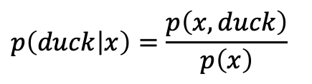
Discriminative vs. Generative
Generative Modeling
Discriminative Model
$$p\left(y | x\right)$$
Generative Model
$$p(x) \text{or} p(x,y)$$
Or, generative models estimate how likely x and y occur together
We can build a discriminative model from this
$$p\left(pig | x\right)=\frac{p\left(x,pig\right)}{p\left(x\right)}$$
$$p\left(duck | x\right)=\frac{p\left(x,duck\right)}{p\left(x\right)}$$
…
$$p(x,pig)$$
$$p(x,duck)$$
$$p(x,dog)$$
$$p(x,monkey)$$
Label: pig

Slide 25
Deep Generative Models
Generative Modeling
Deep Generative Models

Slide 26
Deep Generative Models
Generative Modeling
Explicitness: define an explicit form of p(x)?
Deep Generative Models

Slide 27
Deep Generative Models
Generative Modeling
Explicitness: define an explicit form of p(x)?
Deep Generative Models
Tractability: can p(x) be computed exactly and efficiently?

Slide 28
Deep Generative Models
Generative Modeling
Explicit Tractable
Autoregressive
Normalizing Flows
Deep Generative Models

Slide 29
Deep Generative Models
Generative Modeling
Explicit Tractable
Autoregressive
Normalizing Flows
Explicit Intractable
Variational Autoencoders (VAE)
Diffusion Models*
Score-Based Generative Models
Deep Generative Models

Slide 30
Deep Generative Models
Generative Modeling
Explicit Tractable
Autoregressive
Normalizing Flows
Explicit Intractable
Variational Autoencoders (VAE)
Diffusion Models*
Score-Based Generative Models
Deep Generative Models
Implicit
Generative Adversarial Networks (GANs)

Slide 31
Autoregressive Models

Slide 32

Maximum Likelihood Estimation
Autoregressive Models
Our objective: $p\left(x\right)=f\left(x,W\right)$

Slide 33

Maximum Likelihood Estimation
Autoregressive Models
Our objective: $p\left(x\right)=f\left(x,W\right)$
Given dataset $x_{1},x_{2}, …x_{n}$ train the model by solving:

Slide 34
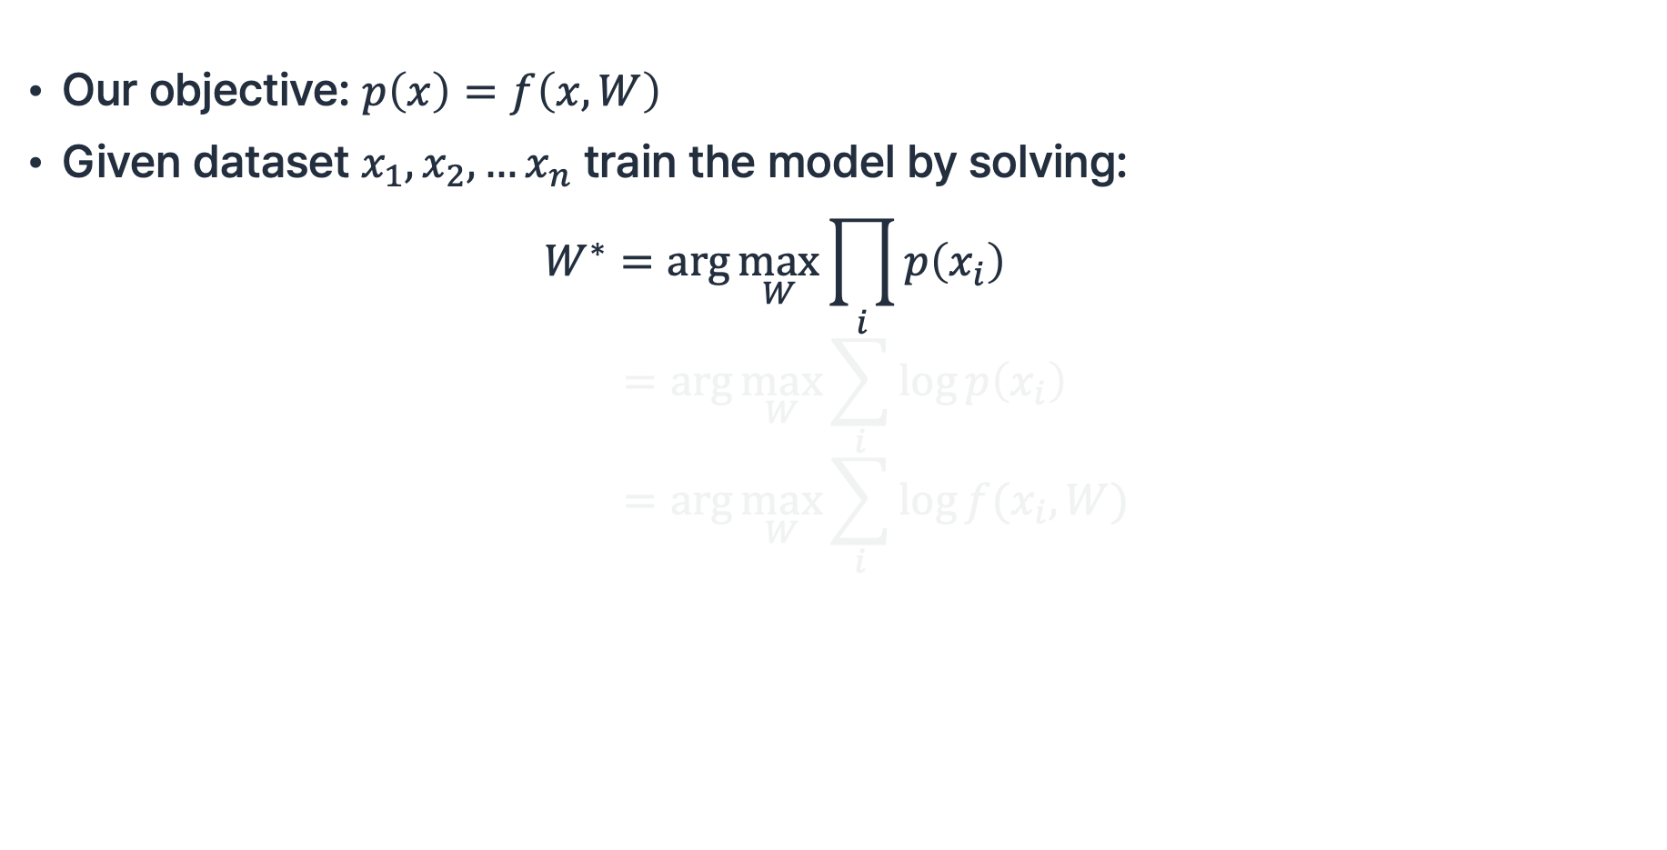
Maximum Likelihood Estimation
Autoregressive Models
Our objective: $p\left(x\right)=f\left(x,W\right)$
Given dataset $x_{1},x_{2}, …x_{n}$ train the model by solving:
$$W^{∗}=\arg{\max_{W}{\prod_{i}{p\left(x_{i}\right)}}} \\ =\arg{\max_{W}{\sum_{i}{\log{p\left(x_{i}\right)}}}} \\ =\arg{\max_{W}{\sum_{i}{\log{f(x_{i},W)}} }}$$

Slide 35
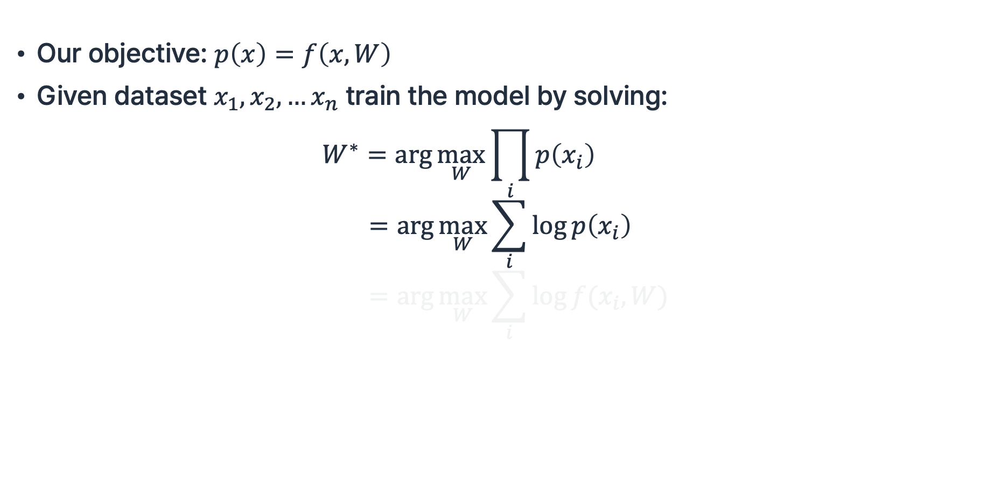
Maximum Likelihood Estimation
Autoregressive Models
Our objective: $p\left(x\right)=f\left(x,W\right)$
Given dataset $x_{1},x_{2}, …x_{n}$ train the model by solving:
$$W^{∗}=\arg{\max_{W}{\prod_{i}{p\left(x_{i}\right)}}} \\ =\arg{\max_{W}{\sum_{i}{\log{p\left(x_{i}\right)}}}} \\ =\arg{\max_{W}{\sum_{i}{\log{f(x_{i},W)}} }}$$

Slide 36
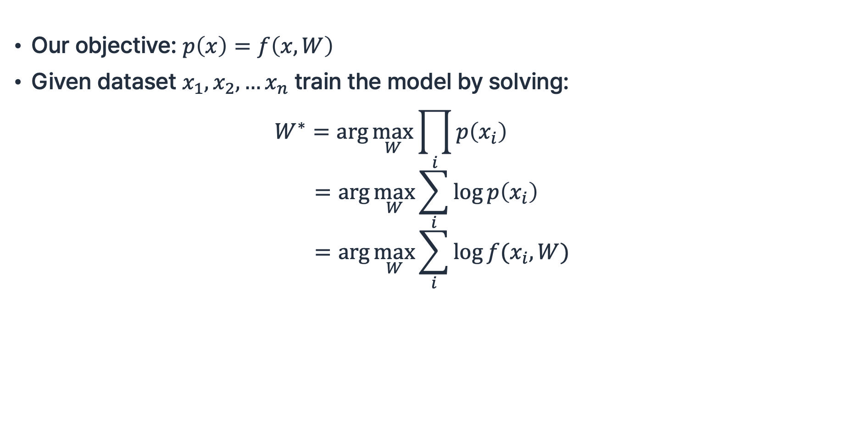
Maximum Likelihood Estimation
Autoregressive Models
Our objective: $p\left(x\right)=f\left(x,W\right)$
Given dataset $x_{1},x_{2}, …x_{n}$ train the model by solving:
$$W^{∗}=\arg{\max_{W}{\prod_{i}{p\left(x_{i}\right)}}} \\ =\arg{\max_{W}{\sum_{i}{\log{p\left(x_{i}\right)}}}} \\ =\arg{\max_{W}{\sum_{i}{\log{f(x_{i},W)}} }}$$

Slide 37

Autoregressive Models
Autoregressive Models
Assume $x$ is a sequence: $x=\left(x_{1},x_{2},…,x_{T}\right)$

Slide 38
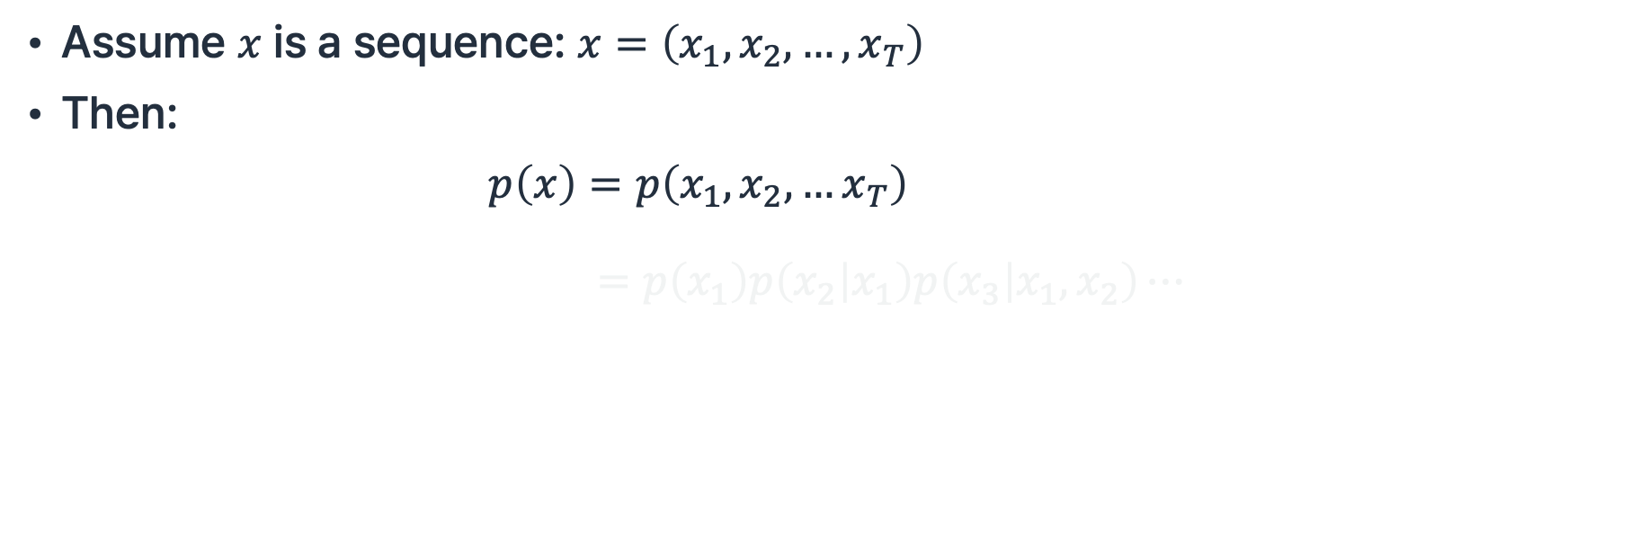
Autoregressive Models
Autoregressive Models
Assume $x$ is a sequence: $x=\left(x_{1},x_{2},…,x_{T}\right)$
Then:
$$p\left(x\right)=p\left(x_{1},x_{2},…x_{T}\right) \\ =p\left(x_{1}\right)p\left(x_{2} | x_{1}\right)p\left(x_{3} | x_{1},x_{2}\right)⋯$$

Slide 39
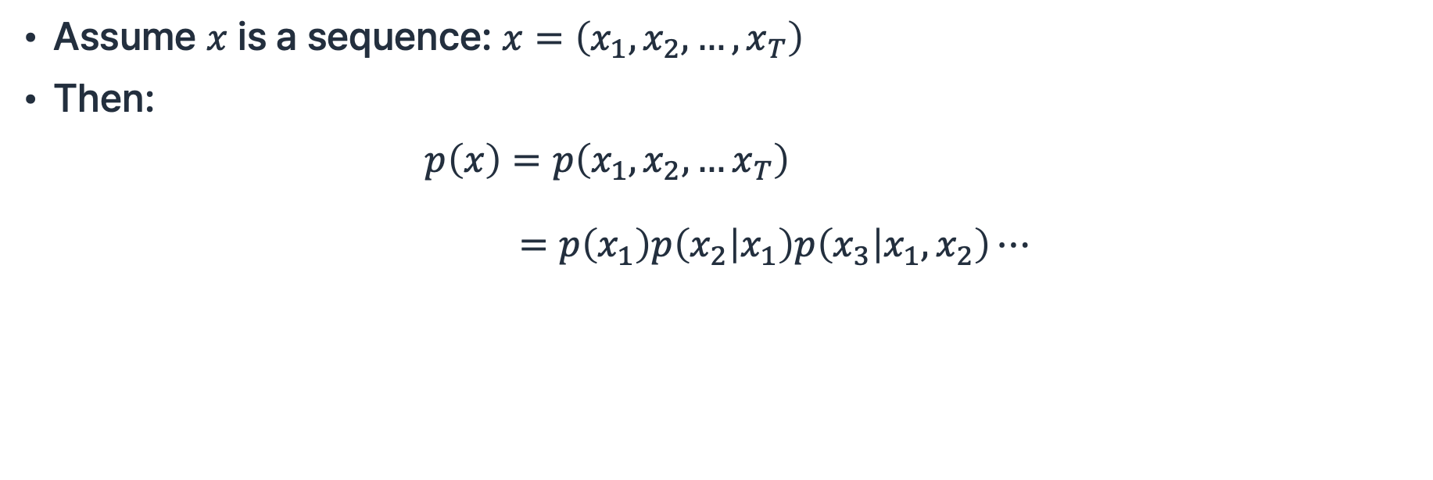
Autoregressive Models
Autoregressive Models
Assume $x$ is a sequence: $x=\left(x_{1},x_{2},…,x_{T}\right)$
Then:
$$p\left(x\right)=p\left(x_{1},x_{2},…x_{T}\right) \\ =p\left(x_{1}\right)p\left(x_{2} | x_{1}\right)p\left(x_{3} | x_{1},x_{2}\right)⋯$$

Slide 40
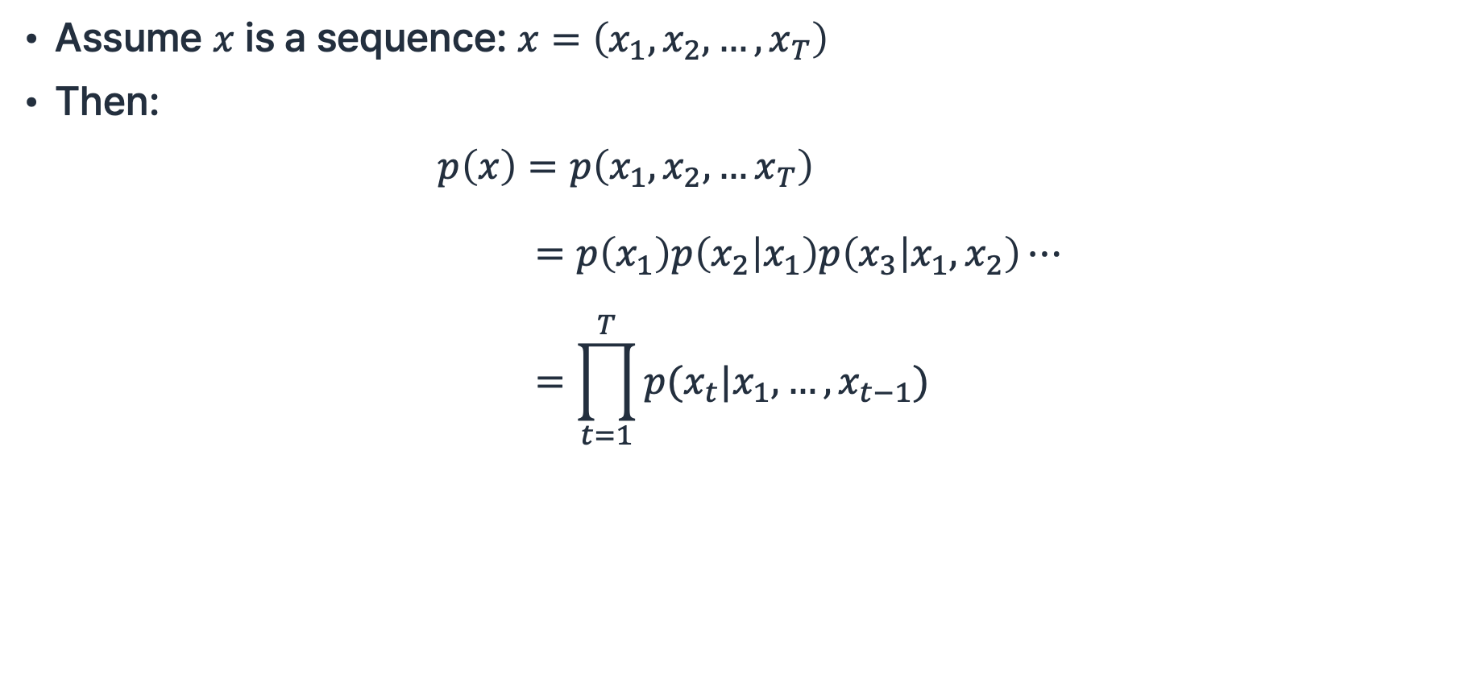
Autoregressive Models
Autoregressive Models
Assume $x$ is a sequence: $x=\left(x_{1},x_{2},…,x_{T}\right)$
Then:
$$p\left(x\right)=p\left(x_{1},x_{2},…x_{T}\right) \\ =p\left(x_{1}\right)p\left(x_{2} | x_{1}\right)p\left(x_{3} | x_{1},x_{2}\right)⋯ \\ =\prod_{t=1}^{T}{p(x_{t}|x_{1},…,x_{t−1})}$$

Slide 41
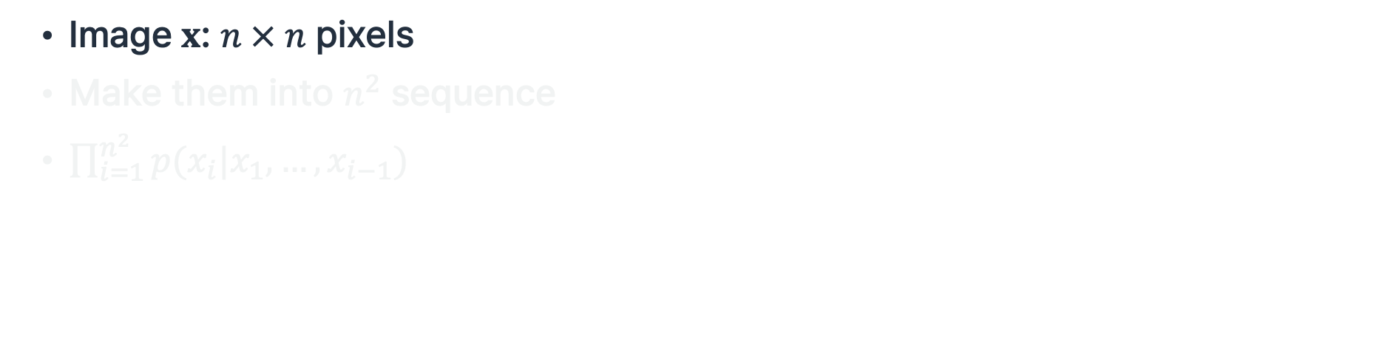
PixelRNN
Autoregressive Models
Image $x$: $n × n$ pixels
Make them into $n^{2}$ sequence
$\prod_{i=1}^{n^{2}}{p(x_{i}|x_{1},…,x_{i−1})}$
van Den Oord et al., “Pixel recurrent neural networks”, ICML 2016.

Slide 42
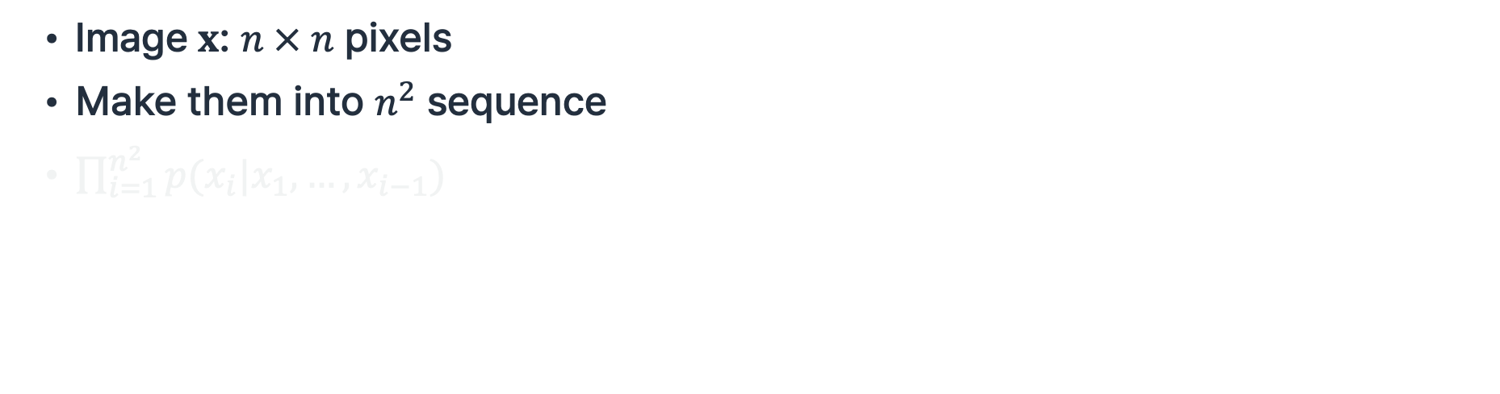
PixelRNN
Autoregressive Models
Image $x$: $n × n$ pixels
Make them into $n^{2}$ sequence
$\prod_{i=1}^{n^{2}}{p(x_{i}|x_{1},…,x_{i−1})}$
van Den Oord et al., “Pixel recurrent neural networks”, ICML 2016.

Slide 43
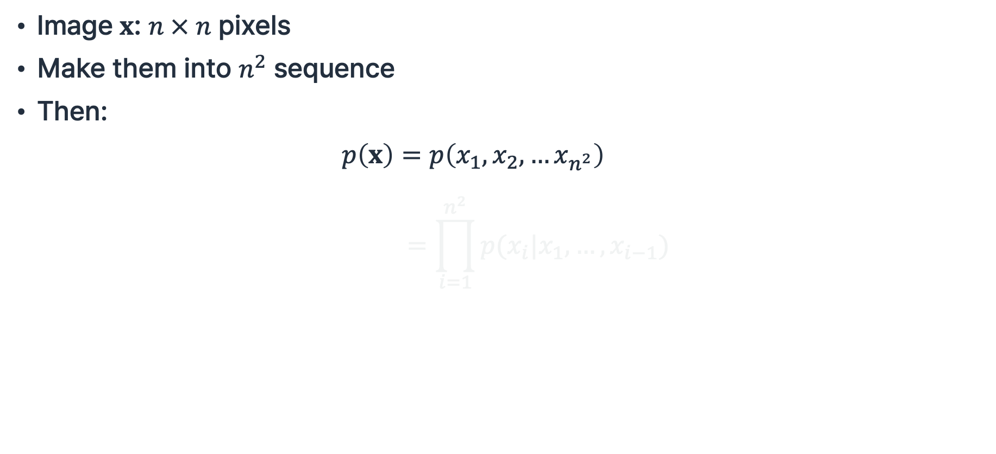
PixelRNN
Autoregressive Models
Image $x$: $n × n$ pixels
Make them into $n^{2}$ sequence
Then:
$$p\left(x\right)=p\left(x_{1},x_{2},…x_{n^{2}}\right) \\ =\prod_{i=1}^{n^{2}}{p(x_{i}|x_{1},…,x_{i−1})}$$
van Den Oord et al., “Pixel recurrent neural networks”, ICML 2016.

Slide 44
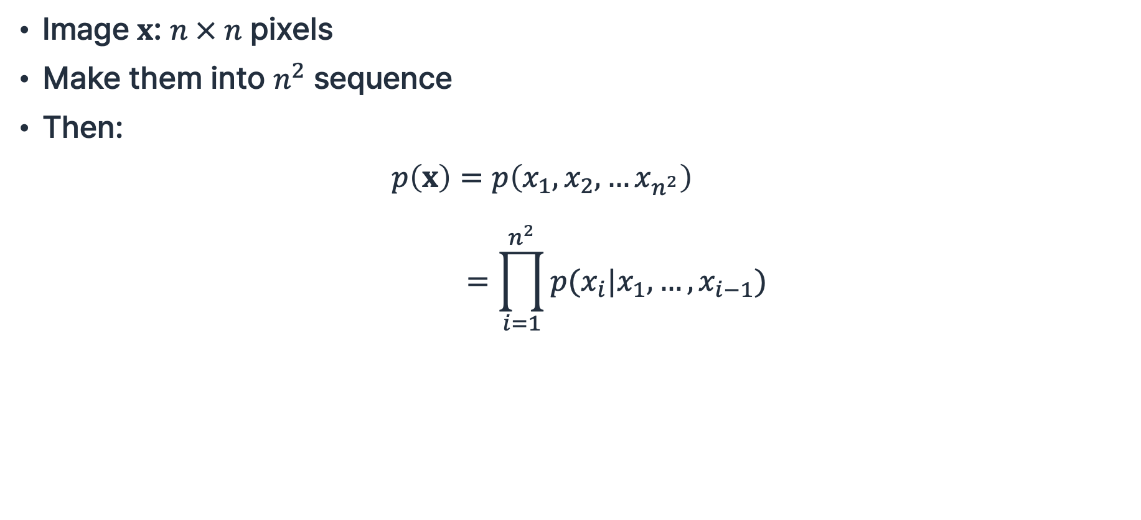
PixelRNN
Autoregressive Models
Image $x$: $n × n$ pixels
Make them into $n^{2}$ sequence
Then:
$$p\left(x\right)=p\left(x_{1},x_{2},…x_{n^{2}}\right) \\ =\prod_{i=1}^{n^{2}}{p(x_{i}|x_{1},…,x_{i−1})}$$
van Den Oord et al., “Pixel recurrent neural networks”, ICML 2016.

Slide 45
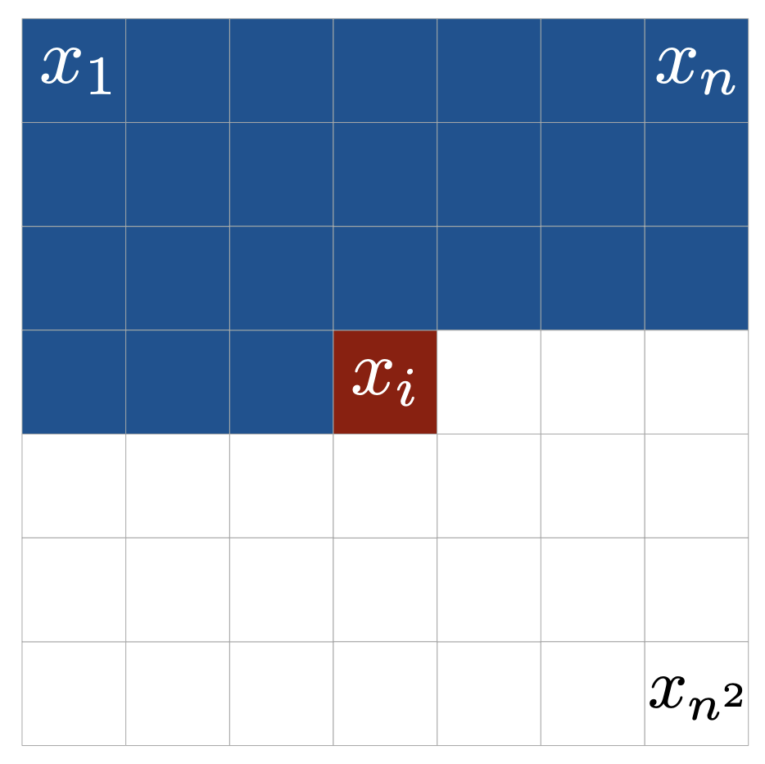
PixelRNN
Autoregressive Models
Context
van Den Oord et al., “Pixel recurrent neural networks”, ICML 2016.

Slide 46
PixelRNN
Autoregressive Models
Context
van Den Oord et al., “Pixel recurrent neural networks”, ICML 2016.

Slide 47
PixelRNN
Autoregressive Models
Context
van Den Oord et al., “Pixel recurrent neural networks”, ICML 2016.

Slide 48
PixelRNN
Autoregressive Models
Context
van Den Oord et al., “Pixel recurrent neural networks”, ICML 2016.

Slide 49
PixelRNN
Autoregressive Models
Context
van Den Oord et al., “Pixel recurrent neural networks”, ICML 2016.

Slide 50
PixelRNN
Autoregressive Models
Sequential generation is extremely slow;
generating 256×256 image requires 65K steps
Context
van Den Oord et al., “Pixel recurrent neural networks”, ICML 2016.

Slide 51
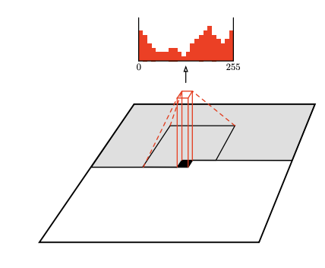
PixelCNN
Autoregressive Models
van Den Oord et al., “Pixel recurrent neural networks”, ICML 2016.

Slide 52
PixelCNN
Autoregressive Models
van Den Oord et al., “Pixel recurrent neural networks”, ICML 2016.

Slide 53
PixelCNN
Autoregressive Models
van Den Oord et al., “Pixel recurrent neural networks”, ICML 2016.

Slide 54
PixelCNN
Autoregressive Models
van Den Oord et al., “Pixel recurrent neural networks”, ICML 2016.

Slide 55
PixelCNN
Autoregressive Models
van Den Oord et al., “Pixel recurrent neural networks”, ICML 2016.

Slide 56
PixelCNN
Autoregressive Models
Slightly faster due to parallelizable generation,
van Den Oord et al., “Pixel recurrent neural networks”, ICML 2016.

Slide 57
PixelCNN
Autoregressive Models
Slightly faster due to parallelizable generation,
however, still very slow
van Den Oord et al., “Pixel recurrent neural networks”, ICML 2016.

Slide 58

PixelRNN Generated Samples
Autoregressive Models
occluded
completions
original
van Den Oord et al., “Pixel recurrent neural networks”, ICML 2016.

Slide 59
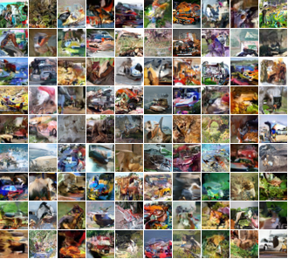
PixelCNN Generated Samples
Autoregressive Models
van Den Oord et al., “Pixel recurrent neural networks”, ICML 2016.

Slide 60
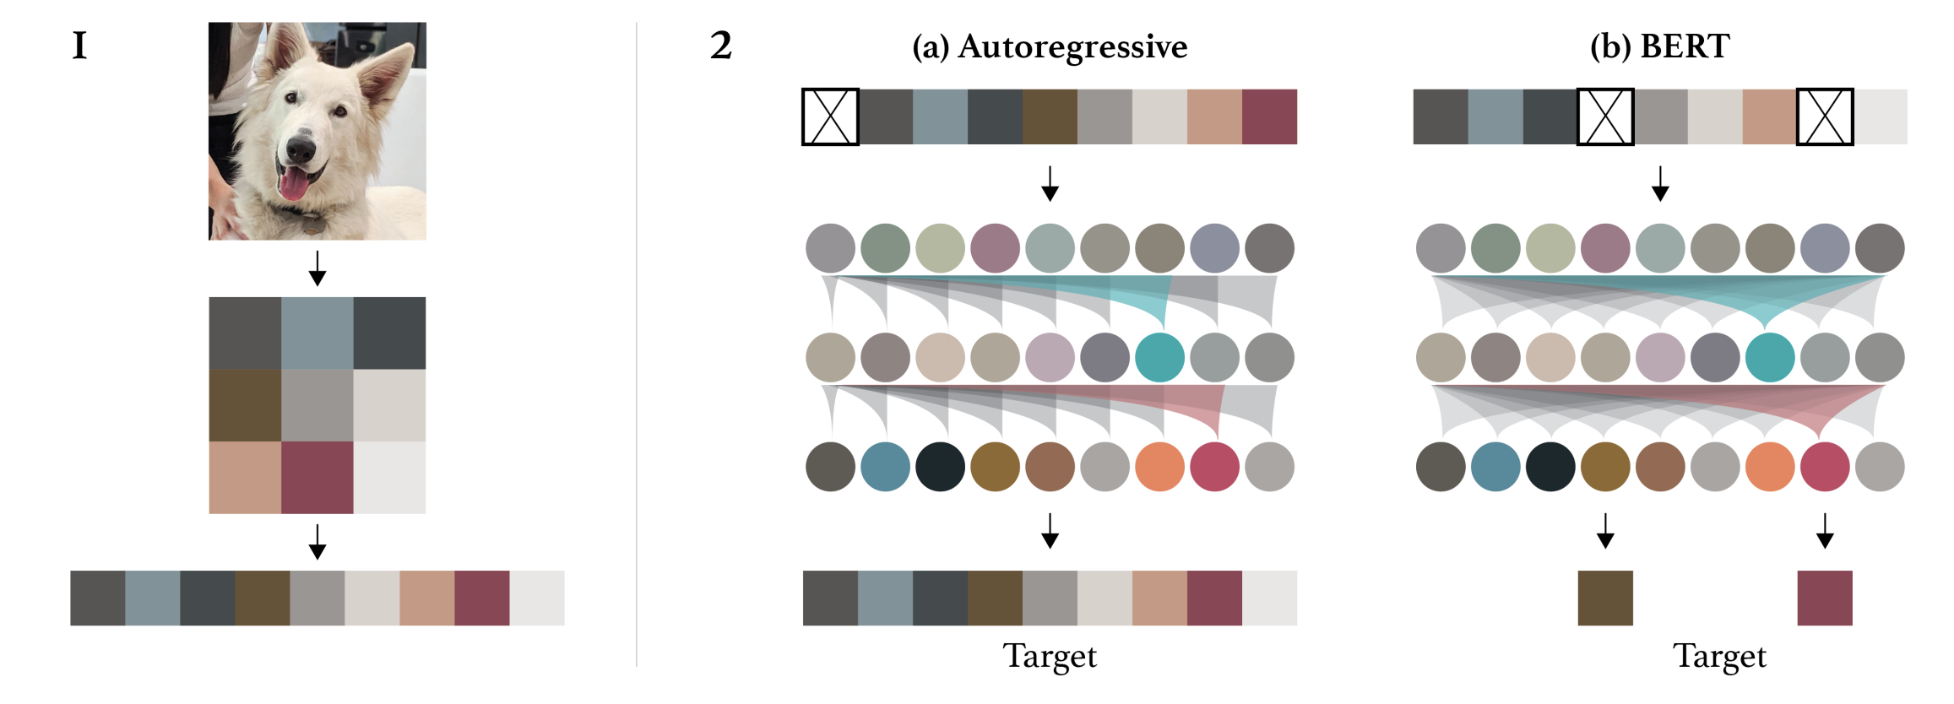
Transformer-based Image Generation
Autoregressive Models
Chen et al., “Generative Pretraining from Pixels”, ICML 2020.

Slide 61
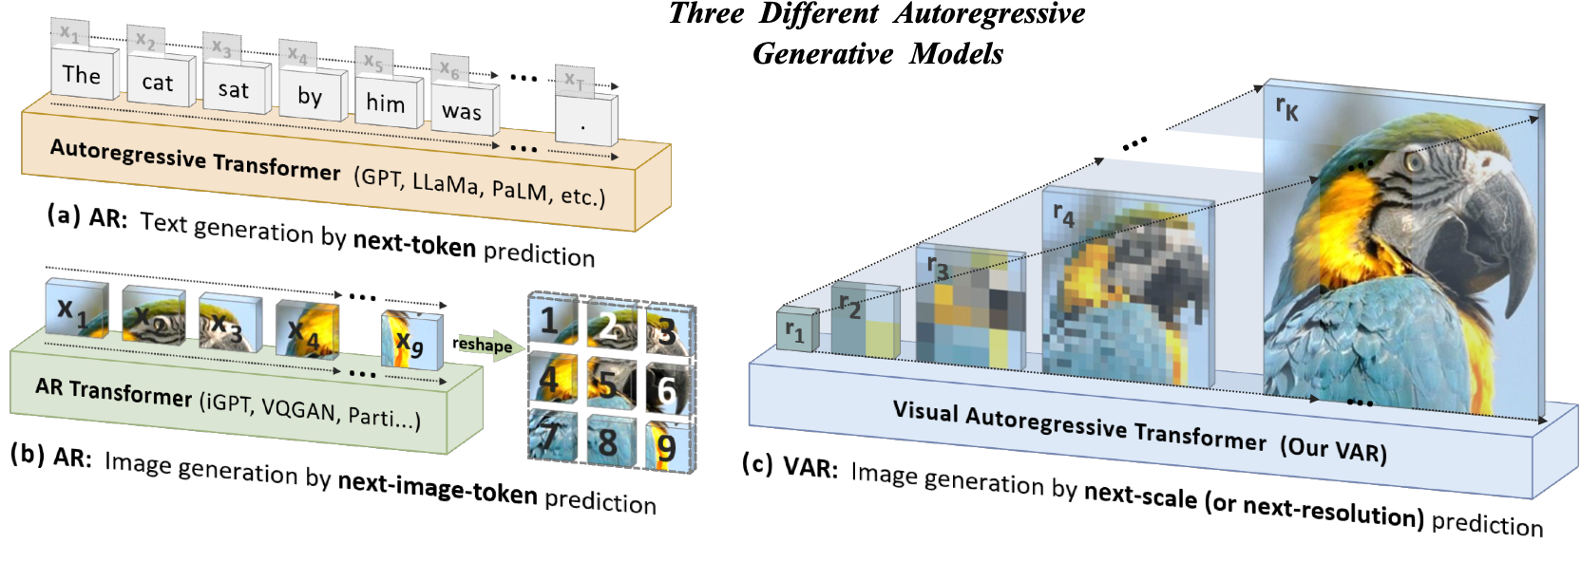
Transformer-based Image Generation
Autoregressive Models
Tian et al., “Visual Autoregressive Modeling: Scalable Image Generation via Next-Scale Prediction.”, NeurIPS 2024.

Slide 62
Variational Autoencoder (VAE)

Slide 63
Autoencoder
Variational Autoencoder
Goal: Learn latent representation z without the label

Slide 64
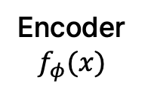

Autoencoder
Variational Autoencoder
Goal: Learn latent representation z without the label
Encoder
$$f_{φ}(x)$$
Image $x$

Slide 65

Autoencoder
Variational Autoencoder
Goal: Learn latent representation z without the label
Encoder
$$f_{φ}(x)$$
$$z$$
Image $x$

Slide 66
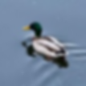

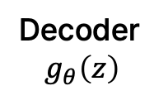
Autoencoder
Variational Autoencoder
Goal: Learn latent representation z without the label
Encoder
$$f_{φ}(x)$$
$$z$$
Decoder
$$g_{θ}\left(z\right)$$
Image $x$
Reconstructed image $\hat{x}$

Slide 67

Autoencoder
Variational Autoencoder
Goal: Learn latent representation z without the label
Encoder
$$f_{φ}(x)$$
$$z$$
Decoder
$$g_{θ}\left(z\right)$$
Image $x$
Reconstructed image $\hat{x}$
Reconstruction Loss ${\left\|\hat{x}−x\right\|}_{2}^{2}$

Slide 68
Autoencoder
Variational Autoencoder
How can we generate new data from this?
Encoder
$$f_{φ}(x)$$
$$z$$
Decoder
$$g_{θ}\left(z\right)$$
Image $x$
Reconstructed image $\hat{x}$

Slide 69
Autoencoder
Variational Autoencoder
How can we generate new data from this?
$$z$$
Decoder
$$g_{θ}\left(z\right)$$
Reconstructed image $\hat{x}$

Slide 70
Autoencoder
Variational Autoencoder
How can we generate new data from this?
  Generate a new z to use decoder to generate images
$$z$$
Decoder
$$g_{θ}\left(z\right)$$
Reconstructed image $\hat{x}$

Slide 71
Autoencoder
Variational Autoencoder
How can we generate new data from this?
  Generate a new z to use decoder to generate images
However, we do not know
the probability distribution of z
$$z$$
Decoder
$$g_{θ}\left(z\right)$$
Reconstructed image $\hat{x}$

Slide 72
Autoencoder
Variational Autoencoder
How can we generate new data from this?
  Generate a new z to use decoder to generate images
However, we do not know
the probability distribution of z
$$z$$
Decoder
$$g_{θ}\left(z\right)$$
Can we make the P(z) nicer?
Reconstructed image $\hat{x}$

Slide 73
Autoencoder
Variational Autoencoder
How can we generate new data from this?
  Generate a new z to use decoder to generate images
However, we do not know
the probability distribution of z
$$z$$
Decoder
$$g_{θ}\left(z\right)$$
Can we make the P(z) nicer?
e.g., p(z)=N(0,I)
Reconstructed image $\hat{x}$

Slide 74
Autoencoder
Variational Autoencoder
How can we generate new data from this?
  Generate a new z to use decoder to generate images
However, we do not know
the probability distribution of z
$$z$$
Decoder
$$g_{θ}\left(z\right)$$
Can we make the P(z) nicer?
e.g., p(z)=N(0,I)
It is easy to sample from a Gaussian
Reconstructed image $\hat{x}$

Slide 75
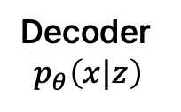
Autoencoder
Variational Autoencoder
How can we generate new data from this?
  Generate a new z to use decoder to generate images
$$z$$
Decoder
$$p_{θ}\left(x|z\right)$$
If $p_{θ}\left(z\right)=𝒩(0,I)$, we can sample latent $z$ from $p_{θ}\left(z\right)$

Slide 76
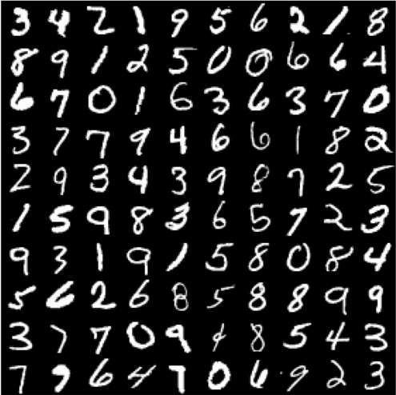
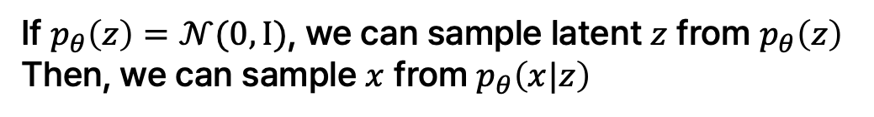
Autoencoder
Variational Autoencoder
How can we generate new data from this?
  Generate a new z to use decoder to generate images
$$z$$
Decoder
$$p_{θ}\left(x|z\right)$$
If $p_{θ}\left(z\right)=𝒩(0,I)$, we can sample latent $z$ from $p_{θ}\left(z\right)$
Then, we can sample $x$ from $p_{θ}\left(x|z\right)$

Slide 77

Autoencoder
Variational Autoencoder
How can we generate new data from this?
  Generate a new z to use decoder to generate images
$$z$$
Decoder
$$p_{θ}\left(x|z\right)$$
If $p_{θ}\left(z\right)=𝒩(0,I)$, we can sample latent $z$ from $p_{θ}\left(z\right)$
Then, we can sample $x$ from $p_{θ}\left(x|z\right)$
How to train $p_{θ}\left(x|z\right)$?

Slide 78
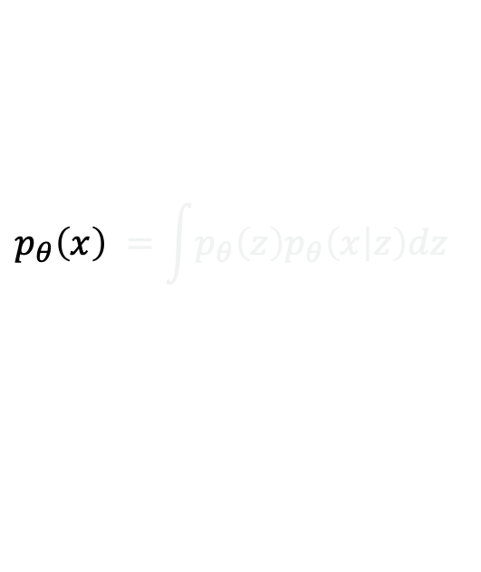
Autoencoder
Variational Autoencoder
How can we generate new data from this?
  Generate a new z to use decoder to generate images
$$z$$
Decoder
$$p_{θ}\left(x|z\right)$$
If $p_{θ}\left(z\right)=𝒩(0,I)$, we can sample latent $z$ from $p_{θ}\left(z\right)$
Then, we can sample $x$ from $p_{θ}\left(x|z\right)$
How to train $p_{θ}\left(x|z\right)$?
$$p_{θ}\left(x\right) =\int{p_{θ}\left(z\right)p_{θ}\left(x | z\right)dz}$$

Slide 79
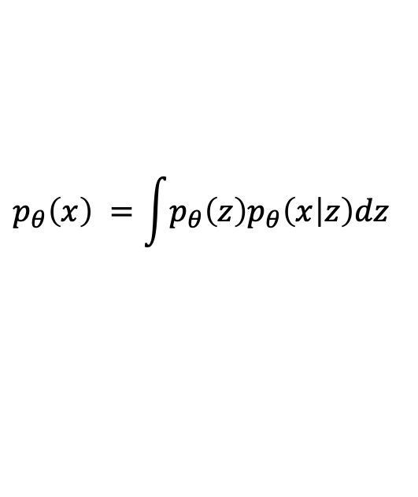
Autoencoder
Variational Autoencoder
How can we generate new data from this?
  Generate a new z to use decoder to generate images
$$z$$
Decoder
$$p_{θ}\left(x|z\right)$$
If $p_{θ}\left(z\right)=𝒩(0,I)$, we can sample latent $z$ from $p_{θ}\left(z\right)$
Then, we can sample $x$ from $p_{θ}\left(x|z\right)$
How to train $p_{θ}\left(x|z\right)$?
$$p_{θ}\left(x\right) =\int{p_{θ}\left(z\right)p_{θ}\left(x | z\right)dz}$$

Slide 80
Autoencoder
Variational Autoencoder
How can we generate new data from this?
  Generate a new z to use decoder to generate images
$$z$$
Decoder
$$p_{θ}\left(x|z\right)$$
If $p_{θ}\left(z\right)=𝒩(0,I)$, we can sample latent $z$ from $p_{θ}\left(z\right)$
Then, we can sample $x$ from $p_{θ}\left(x|z\right)$
How to train $p_{θ}\left(x|z\right)$?
$$p_{θ}\left(x\right) =\int{p_{θ}\left(z\right)p_{θ}\left(x | z\right)dz}$$
Gaussian; easy to compute

Slide 81
Autoencoder
Variational Autoencoder
How can we generate new data from this?
  Generate a new z to use decoder to generate images
$$z$$
Decoder
$$p_{θ}\left(x|z\right)$$
If $p_{θ}\left(z\right)=𝒩(0,I)$, we can sample latent $z$ from $p_{θ}\left(z\right)$
Then, we can sample $x$ from $p_{θ}\left(x|z\right)$
How to train $p_{θ}\left(x|z\right)$?
$$p_{θ}\left(x\right) =\int{p_{θ}\left(z\right)p_{θ}\left(x | z\right)dz}$$
We can compute it using decoder

Slide 82
Autoencoder
Variational Autoencoder
How can we generate new data from this?
  Generate a new z to use decoder to generate images
$$z$$
Decoder
$$p_{θ}\left(x|z\right)$$
If $p_{θ}\left(z\right)=𝒩(0,I)$, we can sample latent $z$ from $p_{θ}\left(z\right)$
Then, we can sample $x$ from $p_{θ}\left(x|z\right)$
How to train $p_{θ}\left(x|z\right)$?
$$p_{θ}\left(x\right) =\int{p_{θ}\left(z\right)p_{θ}\left(x | z\right)dz}$$
Intractable to integrate over z

Slide 83
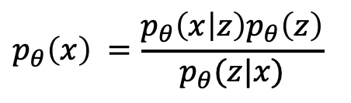
Autoencoder
Variational Autoencoder
How can we generate new data from this?
  Generate a new z to use decoder to generate images
$$z$$
Decoder
$$p_{θ}\left(x|z\right)$$
If $p_{θ}\left(z\right)=𝒩(0,I)$, we can sample latent $z$ from $p_{θ}\left(z\right)$
Then, we can sample $x$ from $p_{θ}\left(x|z\right)$
How to train $p_{θ}\left(x|z\right)$?
$$p_{θ}\left(x\right) =\frac{p_{θ}\left(x | z\right)p_{θ}\left(z\right)}{p_{θ}(z|x)}$$

Slide 84
Autoencoder
Variational Autoencoder
How can we generate new data from this?
  Generate a new z to use decoder to generate images
$$z$$
Decoder
$$p_{θ}\left(x|z\right)$$
If $p_{θ}\left(z\right)=𝒩(0,I)$, we can sample latent $z$ from $p_{θ}\left(z\right)$
Then, we can sample $x$ from $p_{θ}\left(x|z\right)$
How to train $p_{θ}\left(x|z\right)$?
$$p_{θ}\left(x\right) =\frac{p_{θ}\left(x | z\right)p_{θ}\left(z\right)}{p_{θ}(z|x)}$$
easy to compute

Slide 85
Autoencoder
Variational Autoencoder
How can we generate new data from this?
  Generate a new z to use decoder to generate images
$$z$$
Decoder
$$p_{θ}\left(x|z\right)$$
If $p_{θ}\left(z\right)=𝒩(0,I)$, we can sample latent $z$ from $p_{θ}\left(z\right)$
Then, we can sample $x$ from $p_{θ}\left(x|z\right)$
How to train $p_{θ}\left(x|z\right)$?
$$p_{θ}\left(x\right) =\frac{p_{θ}\left(x | z\right)p_{θ}\left(z\right)}{p_{θ}(z|x)}$$
However, we do not know this

Slide 86

Autoencoder
Variational Autoencoder
How can we generate new data from this?
  Generate a new z to use decoder to generate images
$$z$$
Decoder
$$p_{θ}\left(x|z\right)$$
If $p_{θ}\left(z\right)=𝒩(0,I)$, we can sample latent $z$ from $p_{θ}\left(z\right)$
Then, we can sample $x$ from $p_{θ}\left(x|z\right)$
How to train $p_{θ}\left(x|z\right)$?
Approximate it using $q_{φ}\left(z | x\right)$
$$p_{θ}\left(x\right) =\frac{p_{θ}\left(x | z\right)p_{θ}\left(z\right)}{p_{θ}(z|x)}$$
However, we do not know this

Slide 87
Autoencoder
Variational Autoencoder
How can we generate new data from this?
  Generate a new z to use decoder to generate images
$$z$$
Decoder
$$p_{θ}\left(x|z\right)$$
If $p_{θ}\left(z\right)=𝒩(0,I)$, we can sample latent $z$ from $p_{θ}\left(z\right)$
Then, we can sample $x$ from $p_{θ}\left(x|z\right)$
How to train $p_{θ}\left(x|z\right)$?
Approximate it using $q_{φ}\left(z | x\right)$
$$p_{θ}\left(x\right) =\frac{p_{θ}\left(x | z\right)p_{θ}\left(z\right)}{p_{θ}(z|x)}$$
How do we approximate it?

Slide 88
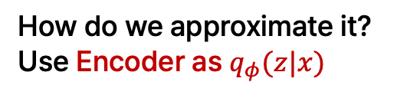
Autoencoder
Variational Autoencoder
How can we generate new data from this?
  Generate a new z to use decoder to generate images
$$z$$
Decoder
$$p_{θ}\left(x|z\right)$$
If $p_{θ}\left(z\right)=𝒩(0,I)$, we can sample latent $z$ from $p_{θ}\left(z\right)$
Then, we can sample $x$ from $p_{θ}\left(x|z\right)$
How to train $p_{θ}\left(x|z\right)$?
Approximate it using $q_{φ}\left(z | x\right)$
$$p_{θ}\left(x\right) =\frac{p_{θ}\left(x | z\right)p_{θ}\left(z\right)}{p_{θ}(z|x)}$$
How do we approximate it?
Use Encoder as $q_{φ}(z|x)$

Slide 89

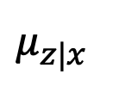
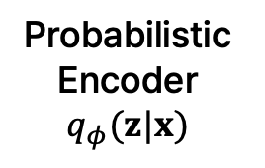
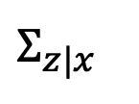
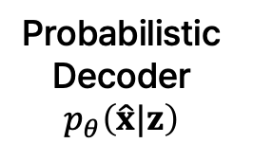
Variational Autoencoder
Variational Autoencoder
Probabilistic
Encoder
$$q_{φ}(z|x)$$
$$Σ_{z|x}$$
Probabilistic
Decoder
$$p_{θ}\left(\hat{x}|z\right)$$
$$z$$
$$μ_{z|x}$$
Image $x$
Reconstructed image $\hat{x}$
Kingma et al., “Auto-encoding Variational Bayes”, ICLR 2014.

Slide 90
Variational Autoencoder
Variational Autoencoder
Probabilistic
Encoder
$$q_{φ}(z|x)$$
$$Σ_{z|x}$$
Probabilistic
Decoder
$$p_{θ}\left(\hat{x}|z\right)$$
$$z$$
$$μ_{z|x}$$
Image $x$
Reconstructed image $\hat{x}$
How do we train this?
Kingma et al., “Auto-encoding Variational Bayes”, ICLR 2014.

Slide 91

Variational Autoencoder
Variational Autoencoder
Probabilistic
Encoder
$$q_{φ}(z|x)$$
$$Σ_{z|x}$$
Probabilistic
Decoder
$$p_{θ}\left(\hat{x}|z\right)$$
$$z$$
$$μ_{z|x}$$
Image $x$
Reconstructed image $\hat{x}$
How do we train this?
Maximize $p\left(x\right)$
Kingma et al., “Auto-encoding Variational Bayes”, ICLR 2014.

Slide 92
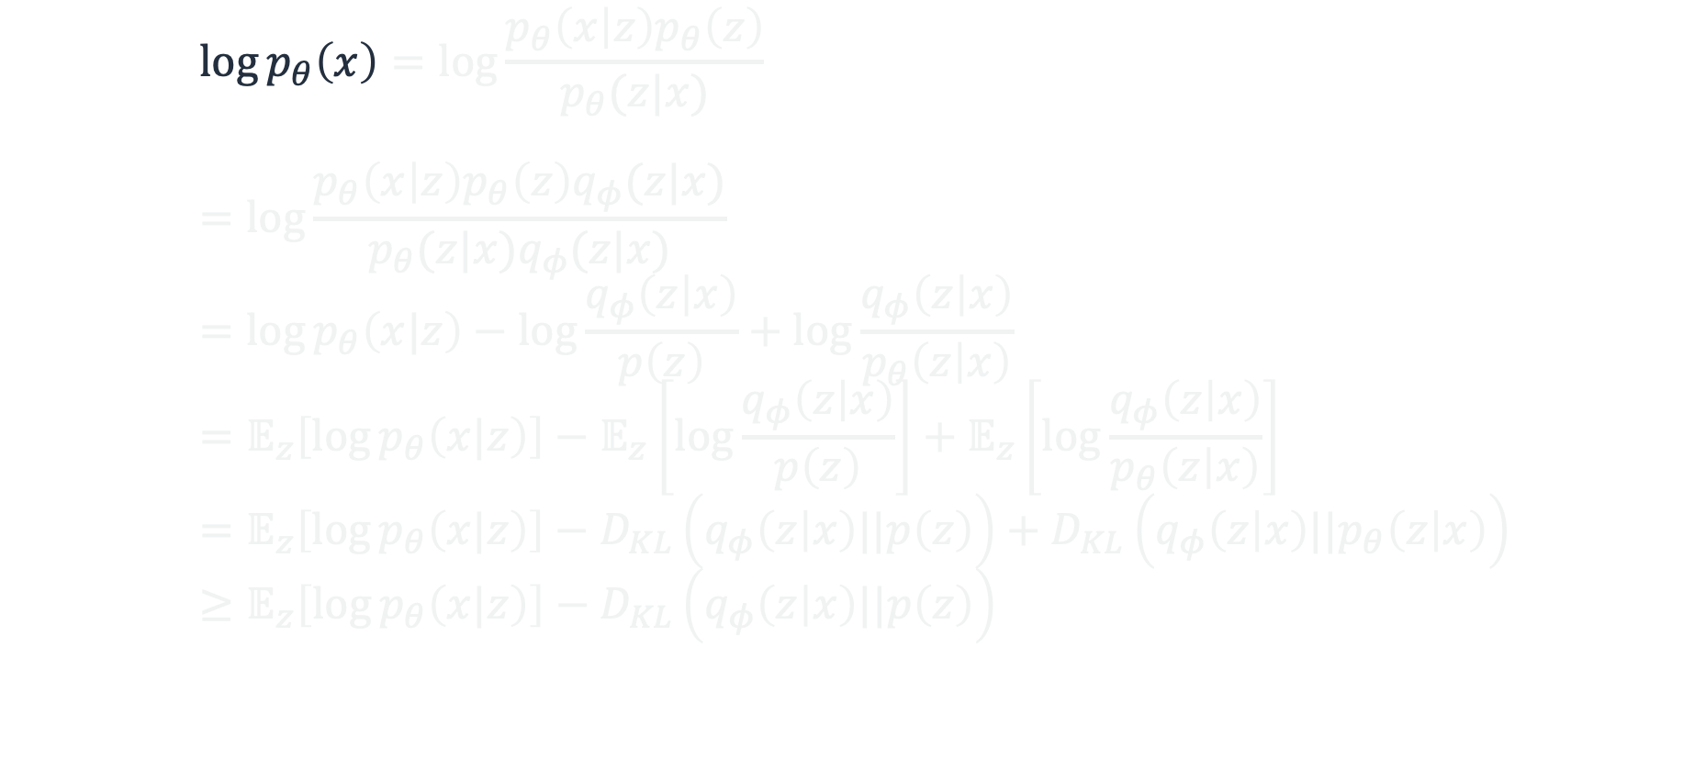
Variational Autoencoder
Variational Autoencoder
$$\log{p_{θ}\left(x\right)}=\log{\frac{p_{θ}\left(x | z\right)p_{θ}\left(z\right)}{p_{θ}(z|x)}} \\ =\log{\frac{p_{θ}\left(x | z\right)p_{θ}\left(z\right)q_{φ}(z|x)}{p_{θ}(z|x)q_{φ}(z|x)}} \\ =\log{p_{θ}\left(x|z\right)}−\log{\frac{q_{φ}\left(z | x\right)}{p\left(z\right)}}+\log{\frac{q_{φ}\left(z | x\right)}{p_{θ}\left(z | x\right)}} \\ =𝔼_{z}\left[\log{p_{θ}\left(x|z\right)}\right]−𝔼_{z}\left[\log{\frac{q_{φ}\left(z | x\right)}{p\left(z\right)}}\right]+𝔼_{z}\left[\log{\frac{q_{φ}\left(z | x\right)}{p_{θ}\left(z | x\right)}}\right] \\ =𝔼_{z}\left[\log{p_{θ}\left(x|z\right)}\right]−D_{KL}\left(q_{φ}\left(z | x\right)||p\left(z\right)\right)+D_{KL}\left(q_{φ}\left(z | x\right)||p_{θ}\left(z | x\right)\right) \\ ≥𝔼_{z}\left[\log{p_{θ}\left(x|z\right)}\right]−D_{KL}\left(q_{φ}\left(z | x\right)||p\left(z\right)\right)$$
Kingma et al., “Auto-encoding Variational Bayes”, ICLR 2014.

Slide 93
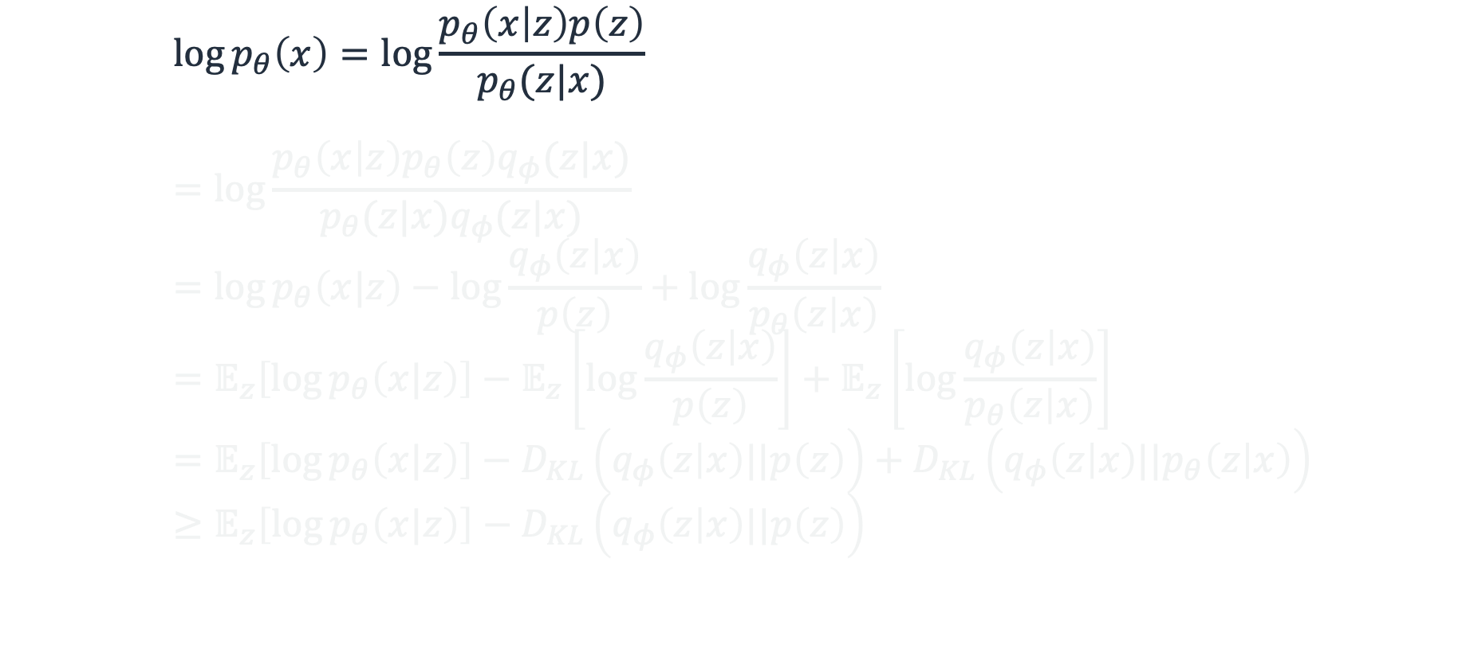
Variational Autoencoder
Variational Autoencoder
$$\log{p_{θ}\left(x\right)}=\log{\frac{p_{θ}\left(x | z\right)p\left(z\right)}{p_{θ}(z|x)}} \\ =\log{\frac{p_{θ}\left(x | z\right)p_{θ}\left(z\right)q_{φ}(z|x)}{p_{θ}(z|x)q_{φ}(z|x)}} \\ =\log{p_{θ}\left(x|z\right)}−\log{\frac{q_{φ}\left(z | x\right)}{p\left(z\right)}}+\log{\frac{q_{φ}\left(z | x\right)}{p_{θ}\left(z | x\right)}} \\ =𝔼_{z}\left[\log{p_{θ}\left(x|z\right)}\right]−𝔼_{z}\left[\log{\frac{q_{φ}\left(z | x\right)}{p\left(z\right)}}\right]+𝔼_{z}\left[\log{\frac{q_{φ}\left(z | x\right)}{p_{θ}\left(z | x\right)}}\right] \\ =𝔼_{z}\left[\log{p_{θ}\left(x|z\right)}\right]−D_{KL}\left(q_{φ}\left(z | x\right)||p\left(z\right)\right)+D_{KL}\left(q_{φ}\left(z | x\right)||p_{θ}\left(z | x\right)\right) \\ ≥𝔼_{z}\left[\log{p_{θ}\left(x|z\right)}\right]−D_{KL}\left(q_{φ}\left(z | x\right)||p\left(z\right)\right)$$
By Bayes’ Rule
Kingma et al., “Auto-encoding Variational Bayes”, ICLR 2014.

Slide 94

Variational Autoencoder
Variational Autoencoder
$$\log{p_{θ}\left(x\right)}=\log{\frac{p_{θ}\left(x | z\right)p\left(z\right)}{p_{θ}(z|x)}}=\log{\frac{p_{θ}\left(x | z\right)p\left(z\right)q_{φ}(z|x)}{p_{θ}(z|x)q_{φ}(z|x)}} \\ =\log{p_{θ}\left(x|z\right)}−\log{\frac{q_{φ}\left(z | x\right)}{p\left(z\right)}}+\log{\frac{q_{φ}\left(z | x\right)}{p_{θ}\left(z | x\right)}} \\ =𝔼_{z}\left[\log{p_{θ}\left(x|z\right)}\right]−𝔼_{z}\left[\log{\frac{q_{φ}\left(z | x\right)}{p\left(z\right)}}\right]+𝔼_{z}\left[\log{\frac{q_{φ}\left(z | x\right)}{p_{θ}\left(z | x\right)}}\right] \\ =𝔼_{z}\left[\log{p_{θ}\left(x|z\right)}\right]−D_{KL}\left(q_{φ}\left(z | x\right)||p\left(z\right)\right)+D_{KL}\left(q_{φ}\left(z | x\right)||p_{θ}\left(z | x\right)\right) \\ ≥𝔼_{z}\left[\log{p_{θ}\left(x|z\right)}\right]−D_{KL}\left(q_{φ}\left(z | x\right)||p\left(z\right)\right)$$
Kingma et al., “Auto-encoding Variational Bayes”, ICLR 2014.

Slide 95

Variational Autoencoder
Variational Autoencoder
$$\log{p_{θ}\left(x\right)}=\log{\frac{p_{θ}\left(x | z\right)p\left(z\right)}{p_{θ}(z|x)}}=\log{\frac{p_{θ}\left(x | z\right)p\left(z\right)q_{φ}(z|x)}{p_{θ}(z|x)q_{φ}(z|x)}} \\ =\log{p_{θ}\left(x|z\right)}−\log{\frac{q_{φ}\left(z | x\right)}{p\left(z\right)}}+\log{\frac{q_{φ}\left(z | x\right)}{p_{θ}\left(z | x\right)}} \\ =𝔼_{z}\left[\log{p_{θ}\left(x|z\right)}\right]−𝔼_{z}\left[\log{\frac{q_{φ}\left(z | x\right)}{p\left(z\right)}}\right]+𝔼_{z}\left[\log{\frac{q_{φ}\left(z | x\right)}{p_{θ}\left(z | x\right)}}\right] \\ =𝔼_{z}\left[\log{p_{θ}\left(x|z\right)}\right]−D_{KL}\left(q_{φ}\left(z | x\right)||p\left(z\right)\right)+D_{KL}\left(q_{φ}\left(z | x\right)||p_{θ}\left(z | x\right)\right) \\ ≥𝔼_{z}\left[\log{p_{θ}\left(x|z\right)}\right]−D_{KL}\left(q_{φ}\left(z | x\right)||p\left(z\right)\right)$$
Kingma et al., “Auto-encoding Variational Bayes”, ICLR 2014.

Slide 96

Variational Autoencoder
Variational Autoencoder
$$\log{p_{θ}\left(x\right)}=𝔼_{z\sim q_{φ}}\left[\log{\frac{p_{θ}\left(x | z\right)p\left(z\right)}{p_{θ}\left(z | x\right)}}\right]=𝔼_{z\sim q_{φ}}\left[\log{\frac{p_{θ}\left(x | z\right)p\left(z\right)q_{φ}\left(z | x\right)}{p_{θ}\left(z | x\right)q_{φ}\left(z | x\right)}}\right] \\ =𝔼_{z\sim q_{φ}}\left[\log{p_{θ}\left(x|z\right)}−\log{\frac{q_{φ}\left(z | x\right)}{p\left(z\right)}}+\log{\frac{q_{φ}\left(z | x\right)}{p_{θ}\left(z | x\right)}}\right] \\ =𝔼_{z\sim q_{φ}}\left[\log{p_{θ}\left(x|z\right)}\right]−𝔼_{z\sim q_{φ}}\left[\log{\frac{q_{φ}\left(z | x\right)}{p\left(z\right)}}\right]+𝔼_{z\sim q_{φ}}\left[\log{\frac{q_{φ}\left(z | x\right)}{p_{θ}\left(z | x\right)}}\right] \\ =𝔼_{z}\left[\log{p_{θ}\left(x|z\right)}\right]−D_{KL}\left(q_{φ}\left(z | x\right)||p\left(z\right)\right)+D_{KL}\left(q_{φ}\left(z | x\right)||p_{θ}\left(z | x\right)\right) \\ ≥𝔼_{z}\left[\log{p_{θ}\left(x|z\right)}\right]−D_{KL}\left(q_{φ}\left(z | x\right)||p\left(z\right)\right)$$
Average over $z\sim q_{φ}$, since $p_{θ}(x)$ does not depend on $z$
Kingma et al., “Auto-encoding Variational Bayes”, ICLR 2014.

Slide 97

Variational Autoencoder
Variational Autoencoder
$$\log{p_{θ}\left(x\right)}=𝔼_{z\sim q_{φ}}\left[\log{\frac{p_{θ}\left(x | z\right)p\left(z\right)}{p_{θ}\left(z | x\right)}}\right]=𝔼_{z\sim q_{φ}}\left[\log{\frac{p_{θ}\left(x | z\right)p\left(z\right)q_{φ}\left(z | x\right)}{p_{θ}\left(z | x\right)q_{φ}\left(z | x\right)}}\right] \\ =𝔼_{z\sim q_{φ}}\left[\log{p_{θ}\left(x|z\right)}−\log{\frac{q_{φ}\left(z | x\right)}{p\left(z\right)}}+\log{\frac{q_{φ}\left(z | x\right)}{p_{θ}\left(z | x\right)}}\right] \\ =𝔼_{z\sim q_{φ}}\left[\log{p_{θ}\left(x|z\right)}\right]−𝔼_{z\sim q_{φ}}\left[\log{\frac{q_{φ}\left(z | x\right)}{p\left(z\right)}}\right]+𝔼_{z\sim q_{φ}}\left[\log{\frac{q_{φ}\left(z | x\right)}{p_{θ}\left(z | x\right)}}\right] \\ =𝔼_{z}\left[\log{p_{θ}\left(x|z\right)}\right]−D_{KL}\left(q_{φ}\left(z | x\right)||p\left(z\right)\right)+D_{KL}\left(q_{φ}\left(z | x\right)||p_{θ}\left(z | x\right)\right) \\ ≥𝔼_{z}\left[\log{p_{θ}\left(x|z\right)}\right]−D_{KL}\left(q_{φ}\left(z | x\right)||p\left(z\right)\right)$$
Kingma et al., “Auto-encoding Variational Bayes”, ICLR 2014.

Slide 98

Variational Autoencoder
Variational Autoencoder
$$\log{p_{θ}\left(x\right)}=𝔼_{z\sim q_{φ}}\left[\log{\frac{p_{θ}\left(x | z\right)p\left(z\right)}{p_{θ}\left(z | x\right)}}\right]=𝔼_{z\sim q_{φ}}\left[\log{\frac{p_{θ}\left(x | z\right)p\left(z\right)q_{φ}\left(z | x\right)}{p_{θ}\left(z | x\right)q_{φ}\left(z | x\right)}}\right] \\ =𝔼_{z\sim q_{φ}}\left[\log{p_{θ}\left(x|z\right)}−\log{\frac{q_{φ}\left(z | x\right)}{p\left(z\right)}}+\log{\frac{q_{φ}\left(z | x\right)}{p_{θ}\left(z | x\right)}}\right] \\ =𝔼_{z\sim q_{φ}}\left[\log{p_{θ}\left(x|z\right)}\right]−𝔼_{z\sim q_{φ}}\left[\log{\frac{q_{φ}\left(z | x\right)}{p\left(z\right)}}\right]+𝔼_{z\sim q_{φ}}\left[\log{\frac{q_{φ}\left(z | x\right)}{p_{θ}\left(z | x\right)}}\right] \\ =𝔼_{z\sim q_{φ}}\left[\log{p_{θ}\left(x|z\right)}\right]−D_{KL}\left(q_{φ}\left(z | x\right)||p\left(z\right)\right)+D_{KL}\left(q_{φ}\left(z | x\right)||p_{θ}\left(z | x\right)\right) \\ =𝔼_{z}\left[\log{p_{θ}\left(x|z\right)}\right]−D_{KL}\left(q_{φ}\left(z | x\right)||p\left(z\right)\right)+D_{KL}\left(q_{φ}\left(z | x\right)||p_{θ}\left(z | x\right)\right) \\ ≥𝔼_{z}\left[\log{p_{θ}\left(x|z\right)}\right]−D_{KL}\left(q_{φ}\left(z | x\right)||p\left(z\right)\right)$$
Kingma et al., “Auto-encoding Variational Bayes”, ICLR 2014.

Slide 99
Variational Autoencoder
Variational Autoencoder
$$\log{p_{θ}\left(x\right)}=𝔼_{z\sim q_{φ}}\left[\log{\frac{p_{θ}\left(x | z\right)p\left(z\right)}{p_{θ}\left(z | x\right)}}\right]=𝔼_{z\sim q_{φ}}\left[\log{\frac{p_{θ}\left(x | z\right)p\left(z\right)q_{φ}\left(z | x\right)}{p_{θ}\left(z | x\right)q_{φ}\left(z | x\right)}}\right] \\ =𝔼_{z\sim q_{φ}}\left[\log{p_{θ}\left(x|z\right)}−\log{\frac{q_{φ}\left(z | x\right)}{p\left(z\right)}}+\log{\frac{q_{φ}\left(z | x\right)}{p_{θ}\left(z | x\right)}}\right] \\ =𝔼_{z\sim q_{φ}}\left[\log{p_{θ}\left(x|z\right)}\right]−𝔼_{z\sim q_{φ}}\left[\log{\frac{q_{φ}\left(z | x\right)}{p\left(z\right)}}\right]+𝔼_{z\sim q_{φ}}\left[\log{\frac{q_{φ}\left(z | x\right)}{p_{θ}\left(z | x\right)}}\right] \\ =𝔼_{z\sim q_{φ}}\left[\log{p_{θ}\left(x|z\right)}\right]−D_{KL}\left(q_{φ}\left(z | x\right)||p\left(z\right)\right)+D_{KL}\left(q_{φ}\left(z | x\right)||p_{θ}\left(z | x\right)\right) \\ =𝔼_{z}\left[\log{p_{θ}\left(x|z\right)}\right]−D_{KL}\left(q_{φ}\left(z | x\right)||p\left(z\right)\right)+D_{KL}\left(q_{φ}\left(z | x\right)||p_{θ}\left(z | x\right)\right) \\ ≥𝔼_{z}\left[\log{p_{θ}\left(x|z\right)}\right]−D_{KL}\left(q_{φ}\left(z | x\right)||p\left(z\right)\right)$$
Data Reconstruction Error
Kingma et al., “Auto-encoding Variational Bayes”, ICLR 2014.

Slide 100
Variational Autoencoder
Variational Autoencoder
$$\log{p_{θ}\left(x\right)}=𝔼_{z\sim q_{φ}}\left[\log{\frac{p_{θ}\left(x | z\right)p\left(z\right)}{p_{θ}\left(z | x\right)}}\right]=𝔼_{z\sim q_{φ}}\left[\log{\frac{p_{θ}\left(x | z\right)p\left(z\right)q_{φ}\left(z | x\right)}{p_{θ}\left(z | x\right)q_{φ}\left(z | x\right)}}\right] \\ =𝔼_{z\sim q_{φ}}\left[\log{p_{θ}\left(x|z\right)}−\log{\frac{q_{φ}\left(z | x\right)}{p\left(z\right)}}+\log{\frac{q_{φ}\left(z | x\right)}{p_{θ}\left(z | x\right)}}\right] \\ =𝔼_{z\sim q_{φ}}\left[\log{p_{θ}\left(x|z\right)}\right]−𝔼_{z\sim q_{φ}}\left[\log{\frac{q_{φ}\left(z | x\right)}{p\left(z\right)}}\right]+𝔼_{z\sim q_{φ}}\left[\log{\frac{q_{φ}\left(z | x\right)}{p_{θ}\left(z | x\right)}}\right] \\ =𝔼_{z\sim q_{φ}}\left[\log{p_{θ}\left(x|z\right)}\right]−D_{KL}\left(q_{φ}\left(z | x\right)||p\left(z\right)\right)+D_{KL}\left(q_{φ}\left(z | x\right)||p_{θ}\left(z | x\right)\right) \\ =𝔼_{z}\left[\log{p_{θ}\left(x|z\right)}\right]−D_{KL}\left(q_{φ}\left(z | x\right)||p\left(z\right)\right)+D_{KL}\left(q_{φ}\left(z | x\right)||p_{θ}\left(z | x\right)\right) \\ ≥𝔼_{z}\left[\log{p_{θ}\left(x|z\right)}\right]−D_{KL}\left(q_{φ}\left(z | x\right)||p\left(z\right)\right)$$
Distribution KL divergence
Kingma et al., “Auto-encoding Variational Bayes”, ICLR 2014.

Slide 101

Variational Autoencoder
Variational Autoencoder
$$\log{p_{θ}\left(x\right)}=𝔼_{z\sim q_{φ}}\left[\log{\frac{p_{θ}\left(x | z\right)p\left(z\right)}{p_{θ}\left(z | x\right)}}\right]=𝔼_{z\sim q_{φ}}\left[\log{\frac{p_{θ}\left(x | z\right)p\left(z\right)q_{φ}\left(z | x\right)}{p_{θ}\left(z | x\right)q_{φ}\left(z | x\right)}}\right] \\ =𝔼_{z\sim q_{φ}}\left[\log{p_{θ}\left(x|z\right)}−\log{\frac{q_{φ}\left(z | x\right)}{p\left(z\right)}}+\log{\frac{q_{φ}\left(z | x\right)}{p_{θ}\left(z | x\right)}}\right] \\ =𝔼_{z\sim q_{φ}}\left[\log{p_{θ}\left(x|z\right)}\right]−𝔼_{z\sim q_{φ}}\left[\log{\frac{q_{φ}\left(z | x\right)}{p\left(z\right)}}\right]+𝔼_{z\sim q_{φ}}\left[\log{\frac{q_{φ}\left(z | x\right)}{p_{θ}\left(z | x\right)}}\right] \\ =𝔼_{z\sim q_{φ}}\left[\log{p_{θ}\left(x|z\right)}\right]−D_{KL}\left(q_{φ}\left(z | x\right)||p\left(z\right)\right)+D_{KL}\left(q_{φ}\left(z | x\right)||p_{θ}\left(z | x\right)\right) \\ =𝔼_{z}\left[\log{p_{θ}\left(x|z\right)}\right]−D_{KL}\left(q_{φ}\left(z | x\right)||p\left(z\right)\right)+D_{KL}\left(q_{φ}\left(z | x\right)||p_{θ}\left(z | x\right)\right) \\ ≥𝔼_{z}\left[\log{p_{θ}\left(x|z\right)}\right]−D_{KL}\left(q_{φ}\left(z | x\right)||p\left(z\right)\right)$$
$p_{θ}(z|x)$ is intractable
Kingma et al., “Auto-encoding Variational Bayes”, ICLR 2014.

Slide 102


Variational Autoencoder
Variational Autoencoder
$$\log{p_{θ}\left(x\right)}=𝔼_{z\sim q_{φ}}\left[\log{\frac{p_{θ}\left(x | z\right)p\left(z\right)}{p_{θ}\left(z | x\right)}}\right]=𝔼_{z\sim q_{φ}}\left[\log{\frac{p_{θ}\left(x | z\right)p\left(z\right)q_{φ}\left(z | x\right)}{p_{θ}\left(z | x\right)q_{φ}\left(z | x\right)}}\right] \\ =𝔼_{z\sim q_{φ}}\left[\log{p_{θ}\left(x|z\right)}−\log{\frac{q_{φ}\left(z | x\right)}{p\left(z\right)}}+\log{\frac{q_{φ}\left(z | x\right)}{p_{θ}\left(z | x\right)}}\right] \\ =𝔼_{z\sim q_{φ}}\left[\log{p_{θ}\left(x|z\right)}\right]−𝔼_{z\sim q_{φ}}\left[\log{\frac{q_{φ}\left(z | x\right)}{p\left(z\right)}}\right]+𝔼_{z\sim q_{φ}}\left[\log{\frac{q_{φ}\left(z | x\right)}{p_{θ}\left(z | x\right)}}\right] \\ =𝔼_{z\sim q_{φ}}\left[\log{p_{θ}\left(x|z\right)}\right]−D_{KL}\left(q_{φ}\left(z | x\right)||p\left(z\right)\right)+D_{KL}\left(q_{φ}\left(z | x\right)||p_{θ}\left(z | x\right)\right) \\ =𝔼_{z}\left[\log{p_{θ}\left(x|z\right)}\right]−D_{KL}\left(q_{φ}\left(z | x\right)||p\left(z\right)\right)+D_{KL}\left(q_{φ}\left(z | x\right)||p_{θ}\left(z | x\right)\right)$$
$p_{θ}(z|x)$ is intractable
$$p_{θ}\left(z | x\right)=\frac{p_{θ}\left(x | z\right)p_{θ}\left(z\right)}{p_{θ}(x)}$$
Kingma et al., “Auto-encoding Variational Bayes”, ICLR 2014.

Slide 103

Variational Autoencoder
Variational Autoencoder
$$\log{p_{θ}\left(x\right)}=𝔼_{z\sim q_{φ}}\left[\log{\frac{p_{θ}\left(x | z\right)p\left(z\right)}{p_{θ}\left(z | x\right)}}\right]=𝔼_{z\sim q_{φ}}\left[\log{\frac{p_{θ}\left(x | z\right)p\left(z\right)q_{φ}\left(z | x\right)}{p_{θ}\left(z | x\right)q_{φ}\left(z | x\right)}}\right] \\ =𝔼_{z\sim q_{φ}}\left[\log{p_{θ}\left(x|z\right)}−\log{\frac{q_{φ}\left(z | x\right)}{p\left(z\right)}}+\log{\frac{q_{φ}\left(z | x\right)}{p_{θ}\left(z | x\right)}}\right] \\ =𝔼_{z\sim q_{φ}}\left[\log{p_{θ}\left(x|z\right)}\right]−𝔼_{z\sim q_{φ}}\left[\log{\frac{q_{φ}\left(z | x\right)}{p\left(z\right)}}\right]+𝔼_{z\sim q_{φ}}\left[\log{\frac{q_{φ}\left(z | x\right)}{p_{θ}\left(z | x\right)}}\right] \\ =𝔼_{z\sim q_{φ}}\left[\log{p_{θ}\left(x|z\right)}\right]−D_{KL}\left(q_{φ}\left(z | x\right)||p\left(z\right)\right)+D_{KL}\left(q_{φ}\left(z | x\right)||p_{θ}\left(z | x\right)\right) \\ =𝔼_{z}\left[\log{p_{θ}\left(x|z\right)}\right]−D_{KL}\left(q_{φ}\left(z | x\right)||p\left(z\right)\right)+D_{KL}\left(q_{φ}\left(z | x\right)||p_{θ}\left(z | x\right)\right) \\ ≥𝔼_{z}\left[\log{p_{θ}\left(x|z\right)}\right]−D_{KL}\left(q_{φ}\left(z | x\right)||p\left(z\right)\right)$$
$p_{θ}(z|x)$ is intractable
but since $D_{KL}≥0$,
$\log{p_{θ}(x)}$ is lower-bounded
Kingma et al., “Auto-encoding Variational Bayes”, ICLR 2014.

Slide 104

Variational Autoencoder
Variational Autoencoder
$$\log{p_{θ}\left(x\right)}=𝔼_{z\sim q_{φ}}\left[\log{\frac{p_{θ}\left(x | z\right)p\left(z\right)}{p_{θ}\left(z | x\right)}}\right]=𝔼_{z\sim q_{φ}}\left[\log{\frac{p_{θ}\left(x | z\right)p\left(z\right)q_{φ}\left(z | x\right)}{p_{θ}\left(z | x\right)q_{φ}\left(z | x\right)}}\right] \\ =𝔼_{z\sim q_{φ}}\left[\log{p_{θ}\left(x|z\right)}−\log{\frac{q_{φ}\left(z | x\right)}{p\left(z\right)}}+\log{\frac{q_{φ}\left(z | x\right)}{p_{θ}\left(z | x\right)}}\right] \\ =𝔼_{z\sim q_{φ}}\left[\log{p_{θ}\left(x|z\right)}\right]−𝔼_{z\sim q_{φ}}\left[\log{\frac{q_{φ}\left(z | x\right)}{p\left(z\right)}}\right]+𝔼_{z\sim q_{φ}}\left[\log{\frac{q_{φ}\left(z | x\right)}{p_{θ}\left(z | x\right)}}\right] \\ =𝔼_{z\sim q_{φ}}\left[\log{p_{θ}\left(x|z\right)}\right]−D_{KL}\left(q_{φ}\left(z | x\right)||p\left(z\right)\right)+D_{KL}\left(q_{φ}\left(z | x\right)||p_{θ}\left(z | x\right)\right) \\ ≥𝔼_{z\sim q_{φ}}\left[\log{p_{θ}\left(x|z\right)}\right]−D_{KL}\left(q_{φ}\left(z | x\right)||p\left(z\right)\right)$$
Kingma et al., “Auto-encoding Variational Bayes”, ICLR 2014.

Slide 105
Variational Autoencoder
Variational Autoencoder
$$\log{p_{θ}\left(x\right)}=𝔼_{z\sim q_{φ}}\left[\log{\frac{p_{θ}\left(x | z\right)p\left(z\right)}{p_{θ}\left(z | x\right)}}\right]=𝔼_{z\sim q_{φ}}\left[\log{\frac{p_{θ}\left(x | z\right)p\left(z\right)q_{φ}\left(z | x\right)}{p_{θ}\left(z | x\right)q_{φ}\left(z | x\right)}}\right] \\ =𝔼_{z\sim q_{φ}}\left[\log{p_{θ}\left(x|z\right)}−\log{\frac{q_{φ}\left(z | x\right)}{p\left(z\right)}}+\log{\frac{q_{φ}\left(z | x\right)}{p_{θ}\left(z | x\right)}}\right] \\ =𝔼_{z\sim q_{φ}}\left[\log{p_{θ}\left(x|z\right)}\right]−𝔼_{z\sim q_{φ}}\left[\log{\frac{q_{φ}\left(z | x\right)}{p\left(z\right)}}\right]+𝔼_{z\sim q_{φ}}\left[\log{\frac{q_{φ}\left(z | x\right)}{p_{θ}\left(z | x\right)}}\right] \\ =𝔼_{z\sim q_{φ}}\left[\log{p_{θ}\left(x|z\right)}\right]−D_{KL}\left(q_{φ}\left(z | x\right)||p\left(z\right)\right)+D_{KL}\left(q_{φ}\left(z | x\right)||p_{θ}\left(z | x\right)\right) \\ ≥𝔼_{z\sim q_{φ}}\left[\log{p_{θ}\left(x|z\right)}\right]−D_{KL}\left(q_{φ}\left(z | x\right)||p\left(z\right)\right)$$
ELBO (Evidence Lower Bound)
Kingma et al., “Auto-encoding Variational Bayes”, ICLR 2014.

Slide 106

Variational Autoencoder
Variational Autoencoder
$$\log{p_{θ}\left(x\right)}=𝔼_{z\sim q_{φ}}\left[\log{\frac{p_{θ}\left(x | z\right)p\left(z\right)}{p_{θ}\left(z | x\right)}}\right]=𝔼_{z\sim q_{φ}}\left[\log{\frac{p_{θ}\left(x | z\right)p\left(z\right)q_{φ}\left(z | x\right)}{p_{θ}\left(z | x\right)q_{φ}\left(z | x\right)}}\right] \\ =𝔼_{z\sim q_{φ}}\left[\log{p_{θ}\left(x|z\right)}−\log{\frac{q_{φ}\left(z | x\right)}{p\left(z\right)}}+\log{\frac{q_{φ}\left(z | x\right)}{p_{θ}\left(z | x\right)}}\right] \\ =𝔼_{z\sim q_{φ}}\left[\log{p_{θ}\left(x|z\right)}\right]−𝔼_{z\sim q_{φ}}\left[\log{\frac{q_{φ}\left(z | x\right)}{p\left(z\right)}}\right]+𝔼_{z\sim q_{φ}}\left[\log{\frac{q_{φ}\left(z | x\right)}{p_{θ}\left(z | x\right)}}\right] \\ =𝔼_{z\sim q_{φ}}\left[\log{p_{θ}\left(x|z\right)}\right]−D_{KL}\left(q_{φ}\left(z | x\right)||p\left(z\right)\right)+D_{KL}\left(q_{φ}\left(z | x\right)||p_{θ}\left(z | x\right)\right) \\ ≥𝔼_{z\sim q_{φ}}\left[\log{p_{θ}\left(x|z\right)}\right]−D_{KL}\left(q_{φ}\left(z | x\right)||p\left(z\right)\right)$$
Kingma et al., “Auto-encoding Variational Bayes”, ICLR 2014.
Image from: https://www.math.emory.edu/site/cmds-reuret/projects/2024-vae/

Slide 107

VAE Generated Samples
Variational Autoencoder
Kingma et al., “Auto-encoding Variational Bayes”, ICLR 2014.

Slide 108


Latent space interpolation
Variational Autoencoder
Kingma et al., “Auto-encoding Variational Bayes”, ICLR 2014.

Slide 109
Generative Adversarial Networks (GANs)

Slide 110

Generate without Explicit $p(x)$
Generative Adversarial Networks
Idea: Generate x directly from a simple prior $p(z)$
$$z$$

Slide 111


Generate without Explicit $p(x)$
Generative Adversarial Networks
Idea: Generate x directly from a simple prior $p(z)$
  e.g., use a neural network $G\left(z\right)$ to generate $\hat{x}$
$$z$$
Generator

Slide 112

Generate without Explicit $p(x)$
Generative Adversarial Networks
Idea: Generate x directly from a simple prior $p(z)$
  e.g., use a neural network $G\left(z\right)$ to generate $\hat{x}$
  Problem: how do we know $\hat{x}$ is realistic without $p(x)$?
$$z$$
Generator

Slide 113


Generate without Explicit $p(x)$
Generative Adversarial Networks
Idea: Generate x directly from a simple prior $p(z)$
  e.g., use a neural network $G\left(z\right)$ to generate $\hat{x}$
  Problem: how do we know $\hat{x}$ is realistic without $p(x)$?
  Use another network to distinguish it from real data
$$z$$
Generator
Real or Fake
Real Images

Slide 114

Generate without Explicit $p(x)$
Generative Adversarial Networks
Idea: Generate x directly from a simple prior $p(z)$
  e.g., use a neural network $G\left(z\right)$ to generate $\hat{x}$
  Problem: how do we know $\hat{x}$ is realistic without $p(x)$?
  Use another network to distinguish it from real data
$$z$$
Generator
Discriminator
Real or Fake
Real Images

Slide 115




Training GANs
Generative Adversarial Networks
Fake Images
Random noise
$$z\sim 𝒩(0,I)$$
$$z$$
Generator
$$G_{θ_{g}}(z)$$
Discriminator
$$D_{θ_{d}}(x)$$
Real or Fake
Training Set
Real Images
Goodfellow, Ian J., et al. "Generative adversarial nets." NIPS 2014.

Slide 116
Training GANs
Generative Adversarial Networks
Fake Images
Random noise
$$z\sim 𝒩(0,I)$$
$$z$$
Generator
$$G_{θ_{g}}(z)$$
Discriminator
$$D_{θ_{d}}(x)$$
Real or Fake
Training Set
Real Images
Discriminator Objective : Distinguish fake images from real images
Goodfellow, Ian J., et al. "Generative adversarial nets." NIPS 2014.

Slide 117
Training GANs
Generative Adversarial Networks
Fake Images
Random noise
$$z\sim 𝒩(0,I)$$
$$z$$
Generator
$$G_{θ_{g}}(z)$$
Discriminator
$$D_{θ_{d}}(x)$$
Real or Fake
Discriminator
Gradient Flow
Training Set
Real Images
Discriminator Objective : Distinguish fake images from real images
Goodfellow, Ian J., et al. "Generative adversarial nets." NIPS 2014.

Slide 118
Training GANs
Generative Adversarial Networks
Fake Images
Random noise
$$z\sim 𝒩(0,I)$$
$$z$$
Generator
$$G_{θ_{g}}(z)$$
Discriminator
$$D_{θ_{d}}(x)$$
Real or Fake
Discriminator
Gradient Flow
Training Set
Real Images
Discriminator Objective : Distinguish fake images from real images
Generator Objective : Fool the discriminator
Goodfellow, Ian J., et al. "Generative adversarial nets." NIPS 2014.

Slide 119
Training GANs
Generative Adversarial Networks
Fake Images
Generator Gradient Flow
Random noise
$$z\sim 𝒩(0,I)$$
$$z$$
Generator
$$G_{θ_{g}}(z)$$
Discriminator
$$D_{θ_{d}}(x)$$
Real or Fake
Discriminator
Gradient Flow
Training Set
Real Images
Discriminator Objective : Distinguish fake images from real images
Generator Objective : Fool the discriminator
Goodfellow, Ian J., et al. "Generative adversarial nets." NIPS 2014.

Slide 120

Training GANs
Generative Adversarial Networks
Fake Images
Generator Gradient Flow
Random noise
$$z\sim 𝒩(0,I)$$
$$z$$
Generator
$$G_{θ_{g}}(z)$$
Discriminator
$$D_{θ_{d}}(x)$$
Real or Fake
Discriminator
Gradient Flow
Training Set
Real Images
Discriminator Objective : Distinguish fake images from real images
Generator Objective : Fool the discriminator
$$\min_{θ_{g}}{\max_{θ_{d}}\left[𝔼_{x\sim p_{data}}\log{D_{θ_{d}}\left(x\right)}+𝔼_{z\sim p\left(z\right)}\log\left(1−D_{θ_{d}}\left(G_{θ_{g}}\left(z\right)\right)\right)\right] }$$
Goodfellow, Ian J., et al. "Generative adversarial nets." NIPS 2014.

Slide 121

Minimax Game
Generative Adversarial Networks
$$\min_{θ_{g}}{\max_{θ_{d}}\left[𝔼_{x\sim p_{data}}\log{D_{θ_{d}}\left(x\right)}+𝔼_{z\sim p\left(z\right)}\log\left(1−D_{θ_{d}}\left(G_{θ_{g}}\left(z\right)\right)\right)\right] }$$
Goodfellow, Ian J., et al. "Generative adversarial nets." NIPS 2014.

Slide 122
Minimax Game
Generative Adversarial Networks
Discriminator Objective : Distinguish fake images from real images
$$\min_{θ_{g}}{\max_{θ_{d}}\left[𝔼_{x\sim p_{data}}\log{D_{θ_{d}}\left(x\right)}+𝔼_{z\sim p\left(z\right)}\log\left(1−D_{θ_{d}}\left(G_{θ_{g}}\left(z\right)\right)\right)\right] }$$
Goodfellow, Ian J., et al. "Generative adversarial nets." NIPS 2014.

Slide 123

Minimax Game
Generative Adversarial Networks
Discriminator Objective : Distinguish fake images from real images
$$\min_{θ_{g}}{\max_{θ_{d}}\left[𝔼_{x\sim p_{data}}\log{D_{θ_{d}}\left(x\right)}+𝔼_{z\sim p\left(z\right)}\log\left(1−D_{θ_{d}}\left(G_{θ_{g}}\left(z\right)\right)\right)\right] }$$
maximize
minimize
Goodfellow, Ian J., et al. "Generative adversarial nets." NIPS 2014.

Slide 124


Minimax Game
Generative Adversarial Networks
Discriminator Objective : Distinguish fake images from real images
$$\min_{θ_{g}}{\max_{θ_{d}}\left[𝔼_{x\sim p_{data}}\log{D_{θ_{d}}\left(x\right)}+𝔼_{z\sim p\left(z\right)}\log\left(1−D_{θ_{d}}\left(G_{θ_{g}}\left(z\right)\right)\right)\right] }$$
maximize
minimize
log x
log (1-x)
Goodfellow, Ian J., et al. "Generative adversarial nets." NIPS 2014.

Slide 125
Minimax Game
Generative Adversarial Networks
Discriminator Objective : Distinguish fake images from real images
Real data
$$\min_{θ_{g}}{\max_{θ_{d}}\left[𝔼_{x\sim p_{data}}\log{D_{θ_{d}}\left(x\right)}+𝔼_{z\sim p\left(z\right)}\log\left(1−D_{θ_{d}}\left(G_{θ_{g}}\left(z\right)\right)\right)\right] }$$
maximize
minimize
log x
log (1-x)
Goodfellow, Ian J., et al. "Generative adversarial nets." NIPS 2014.

Slide 126
Minimax Game
Generative Adversarial Networks
Discriminator Objective : Distinguish fake images from real images
Real data
Fake data
$$\min_{θ_{g}}{\max_{θ_{d}}\left[𝔼_{x\sim p_{data}}\log{D_{θ_{d}}\left(x\right)}+𝔼_{z\sim p\left(z\right)}\log\left(1−D_{θ_{d}}\left(G_{θ_{g}}\left(z\right)\right)\right)\right] }$$
maximize
minimize
log x
log (1-x)
Goodfellow, Ian J., et al. "Generative adversarial nets." NIPS 2014.

Slide 127

Minimax Game
Generative Adversarial Networks
Discriminator Objective : Distinguish fake images from real images
Generator Objective : Fool the discriminator
$$\min_{θ_{g}}{\max_{θ_{d}}\left[𝔼_{x\sim p_{data}}\log{D_{θ_{d}}\left(x\right)}+𝔼_{z\sim p\left(z\right)}\log\left(1−D_{θ_{d}}\left(G_{θ_{g}}\left(z\right)\right)\right)\right] }$$
Goodfellow, Ian J., et al. "Generative adversarial nets." NIPS 2014.

Slide 128
Minimax Game
Generative Adversarial Networks
Discriminator Objective : Distinguish fake images from real images
Generator Objective : Fool the discriminator
Independent of generator
$$\min_{θ_{g}}{\max_{θ_{d}}\left[𝔼_{x\sim p_{data}}\log{D_{θ_{d}}\left(x\right)}+𝔼_{z\sim p\left(z\right)}\log\left(1−D_{θ_{d}}\left(G_{θ_{g}}\left(z\right)\right)\right)\right] }$$
Goodfellow, Ian J., et al. "Generative adversarial nets." NIPS 2014.

Slide 129
Minimax Game
Generative Adversarial Networks
Discriminator Objective : Distinguish fake images from real images
Generator Objective : Fool the discriminator
Independent of generator
$$\min_{θ_{g}}{\max_{θ_{d}}\left[𝔼_{x\sim p_{data}}\log{D_{θ_{d}}\left(x\right)}+𝔼_{z\sim p\left(z\right)}\log\left(1−D_{θ_{d}}\left(G_{θ_{g}}\left(z\right)\right)\right)\right] }$$
maximize
log (1-x)
Goodfellow, Ian J., et al. "Generative adversarial nets." NIPS 2014.

Slide 130
Minimax Game
Generative Adversarial Networks
Discriminator Objective : Distinguish fake images from real images
Generator Objective : Fool the discriminator
Independent of generator
Minimize by making D(G(z))->1
$$\min_{θ_{g}}{\max_{θ_{d}}\left[𝔼_{x\sim p_{data}}\log{D_{θ_{d}}\left(x\right)}+𝔼_{z\sim p\left(z\right)}\log\left(1−D_{θ_{d}}\left(G_{θ_{g}}\left(z\right)\right)\right)\right] }$$
maximize
log (1-x)
Goodfellow, Ian J., et al. "Generative adversarial nets." NIPS 2014.

Slide 131

Training Dynamics of GANs
Generative Adversarial Networks
Discriminator : Blue dashed line
Generator : Green solid line
Data distribution : black dotted line
Goodfellow, Ian J., et al. "Generative adversarial nets." NIPS 2014.

Slide 132
Training Dynamics of GANs
Generative Adversarial Networks
Transformation from distribution p(z)
Discriminator : Blue dashed line
Generator : Green solid line
Data distribution : black dotted line
Goodfellow, Ian J., et al. "Generative adversarial nets." NIPS 2014.

Slide 133

Training Dynamics of GANs
Generative Adversarial Networks
At first, $p_{g}$ is different from $p_{data}$
Transformation from distribution p(z)
Discriminator : Blue dashed line
Generator : Green solid line
Data distribution : black dotted line
Goodfellow, Ian J., et al. "Generative adversarial nets." NIPS 2014.

Slide 134

Training Dynamics of GANs
Generative Adversarial Networks
At first, $p_{g}$ is different from $p_{data}$
Discriminator can easily distinguish generated samples
Transformation from distribution p(z)
Discriminator : Blue dashed line
Generator : Green solid line
Data distribution : black dotted line
Goodfellow, Ian J., et al. "Generative adversarial nets." NIPS 2014.

Slide 135


Training Dynamics of GANs
Generative Adversarial Networks
$G(z)$ is trained to map $p_{g}$ to resemble $p_{data}$
Goodfellow, Ian J., et al. "Generative adversarial nets." NIPS 2014.

Slide 136

Training Dynamics of GANs
Generative Adversarial Networks
Goodfellow, Ian J., et al. "Generative adversarial nets." NIPS 2014.

Slide 137


Training Dynamics of GANs
Generative Adversarial Networks
Finally, $D$ cannot discriminate $p_{g}$ from $p_{data}$,
Goodfellow, Ian J., et al. "Generative adversarial nets." NIPS 2014.

Slide 138

Training Dynamics of GANs
Generative Adversarial Networks
Finally, $D$ cannot discriminate $p_{g}$ from $p_{data}$,
converging to $D\left(x\right)=\frac{p_{data}\left(x\right)}{p_{data}\left(x\right)+p_{g}(x)}=\frac{1}{2}$
Goodfellow, Ian J., et al. "Generative adversarial nets." NIPS 2014.

Slide 139


Generated Samples
Generative Adversarial Networks
MNIST Digits Dataset
Toronto Faces Dataset
Rightmost column shows the nearest training example
Goodfellow, Ian J., et al. "Generative adversarial nets." NIPS 2014.

Slide 140


Interpolating Latent Variables
Generative Adversarial Networks
Interpolating z visualizes transitions in high-level features
Goodfellow, Ian J., et al. "Generative adversarial nets." NIPS 2014.

Slide 141

Interpolating Latent Variables
Generative Adversarial Networks
Brock et al., ”Large Scale GAN Training For High Fidelity Natural Image Synthesis." ICLR 2019.

Slide 142

High Resolution Image Generation
Generative Adversarial Networks
Karrase et al. ” A Style-Based Generator Architecture for Generative Adversarial Networks." CVPR 2019.

Slide 143

Style Transfer
Generative Adversarial Networks
Karrase et al. ” A Style-Based Generator Architecture for Generative Adversarial Networks." CVPR 2019.

Slide 144

Style Transfer
Generative Adversarial Networks
Zhu et al. ”Unpaired Image-to-Image Translation using Cycle-Consistent Adversarial Networks." CVPR 2019.

Slide 145







Summary
Generative Modeling
Probabilistic
Encoder
$$q_{φ}(z|x)$$
$$Σ_{z|x}$$
Probabilistic
Decoder
$$p_{θ}\left(\hat{x}|z\right)$$
$$z$$
$$μ_{z|x}$$
Image $x$
Reconstructed image $\hat{x}$
Fake Images
Random noise
$$z\sim 𝒩(0,I)$$
$$z$$
Generator
$$G_{θ_{g}}(z)$$
Discriminator
$$D_{θ_{d}}(x)$$
Real or Fake
Training Set
Real Images

Slide 146
Further Resources
Generative Modeling
Stanford cs231n Deep Learning for Computer Vision (Feifei Li et al.)
  https://cs231n.stanford.edu/
Stanford cs236 Deep Generative Models (Stefano Ermon et al.)
  https://deepgenerativemodels.github.io/
Princeton COS597C Advanced Methods in Probabilistic Modeling, Variational Inference Lecture Note (David M. Blei)
  https://www.cs.princeton.edu/courses/archive/fall11/cos597C/lectures/variational-inference-i.pdf

Slide 147


Jihwan Hong
AIDAS Lab
Seoul National University

